Slide 1
Guidance for International Growth Standards (gigs) package - new egen functions for international newborn and child growth standards
Simon Parker
7th September 2023
Notes:
Hi all, I hope you’re all well rested after that tea break. I’m Simon Parker, a research assistant from the London School of Hygiene and Tropical Medicine, and I’m here to talk to you all today about a new package for growth analysis in Stata using international, prescriptive growth standards.

Slide 2
Talk structure
Background
The gigs package
Demonstrations
Round-up and acknowledgments
Notes:
My talk is split into three blocks and an outro. I’ll first cover some conceptual background information and give a quick overview of why this package was needed and what gaps it addresses. I’ll follow this with an overview of the functions available in gigs and their syntax, and finally demonstrate the package in action to you all. Finally, I’ll round the talk up and address any questions from you all.

Slide 3
Background | Why care about growth?
Newborn and child growth captures more than just feeding habits¹
For individuals²
  Associated with failure to thrive in later life, illness and death
At an international scale³
  Sustainable Development Goals
Attanasio, O., Cattan, S., & Meghir, C. (2022). Annual Reviews of Economics, 14(1) 853–892.
Victora, C.G. et al. (2022). The Lancet, 399(10336), 1741–1752.
WHO/UNICEF. 2019. WHO/UNICEF discussion paper: The extension of the 2025 maternal, infant and young child nutrition targets to 2030. https://data.unicef.org/resources/who-unicef-discussion-paper-nutrition-targets/ (accessed August 30th, 2023).
Notes:
First, an introduction to growth, its analysis, and why it matters.
Child growth captures not only how an individual is growing but is a consequence of wider societal trends – growth is linked to the economic development of countries and can be used to characterise global health inequalities. For individuals, failure to grow in early life correlates with failure to thrive in later life, and on a global scale poor growth is associated with most unnecessary neonatal and infant deaths. To achieve the Sustainable Development Goals set out by UNICEF, we need to improve child growth and its monitoring.

Slide 4
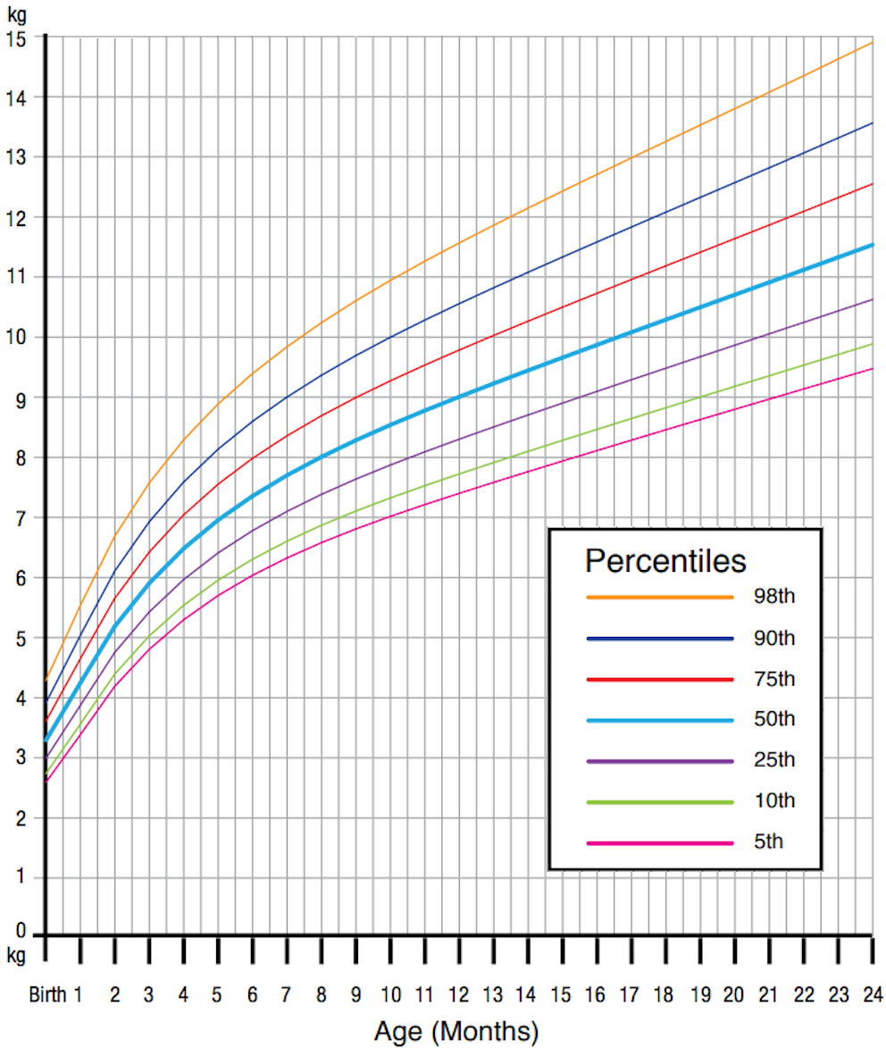
Background | Analysing growth
Weight (kg) vs age in months by percentile
“How big is this baby
relative to others of
its age and sex?”
Weight (kg)
Notes:
In essence, growth analysis centres on one question – “how big is this baby relative to others of its age and sex?”. In the clinic, you could take a chart like this one showing the expected weights of female babies relative to their age and say: I have an eleven kilogramme baby. They are eleven months old. Therefore, they are bigger than at least 90% of babies according to this graph. You could also quantify the growth of children in terms of z-scores, where you work out the number of standard deviations between a child’s size and the mean size.

Slide 5
Background | Growth standards vs. references
The population you compare against matters
 | Growth references | International growth standards
Health of population | All babies/children used irrespective of health | Healthy, breast-fed infants
Relevancy | Relevant to population used to generate standard | Internationally relevant
Information gathered | How children did grow | How children should grow
Uauy, R, Cansello P., Krause B., Kusanovic JP., Corvalan C. (2013). British Journal of Obstetrics and Gynaecology, 120(S2), 3-8.
Notes:
The graph being used matters. Each of these growth charts can be generated using data from thousands or even tens of thousands of babies, and the makeup of this population determines the utility of the growth chart. For our purposes – the consistent analysis of growth across different populations, we want to focus on international growth standards. This is because they use only healthy infants in their study populations, and therefore capture ‘optimal’ growth for an international sample of babies. In contrast, a growth reference is useful for identifying how children of a given population have grown relative to other babies of that given population, but their use is limited when performing cross-country comparisons.

Slide 6
Background | International, prescriptive standards
Timepoint | Term infants | Preterm infants
At birth: | INTERGROWTH-21st Newborn Size Standards¹⁻³ | INTERGROWTH-21st Newborn Size Standards¹⁻³
After birth: | WHO Growth Standards⁴ | INTERGROWTH-21st Postnatal Growth Standards⁵
Issues in application:
WHO standards often incorrectly applied to preterm infants⁶
Systematic changes to growth quantification when WHO
standards used at birth⁷
Villar J. et al. (2014). The Lancet, 384(9946), 857-68.
Villar J. et al. (2016). The Lancet, 387(10021), 844-845.
Villar J. et al. (2017). Pediatric Research, 82, 305–316.
WHO Multicentre Growth Reference Study Group and de Onis M. (2006). Acta Paediatrica Supplement, 450, 76-85.
Villar J. et al. (2015). Lancet Glob Health 3(11), e681-e691.
Perumal N., Gaffey M.F., Bassani D.G., Roth D.E. (2015). The Journal of Nutrition, 145(11), 2429-2439.
Perumal N., Ohuma E.O., Prentice A.M., Shah P.S., Al Mahmud A., Moore S.E., Roth D.E. (2022). Paediatric and Perinatal Epidemiology, 36, 839-850.
Notes:
If we care about monitoring growth and the tools used to do this, we should also make sure that these tools are being used correctly: at birth, the INTERGROWTH-21st Newborn Size Standards are currently the best available growth standards. After birth, the WHO or INTERGROWTH-21st Postnatal Growth Standards are best for term and preterm infants, respectively. Unfortunately, though the right tools are in use by many, they are often applied incorrectly – for example, the WHO standards are often used to analyse data from preterm infants, even though this is not advised.

Slide 7





Background | Guidance for International Growth Standards
Aim: Consistent application of internationally-relevant prescriptive growth standards
Guidance documentation
Software packages
Web platform
Notes:
Suboptimal analysis precipitates suboptimal data, which is why the Guidance for International Growth Standards – or GIGS – project are working on guidance for when and where to use each standard. We’re also working on software packages which include these international standards in Stata, R, and SAS. Finally, we aim to make public a web platform which will operationalise these software packages for use through web browsers.

Slide 8

Background | The Stata landscape
‘zanthro’ package¹
  Extensions to egen with WHO growth standards
  Also contains CDC/UK growth references, which are outside the scope of GIGS
No existing Stata packages for INTERGROWTH-21st standards
  Stata forum – a post asking for an INTERGROWTH-21st command…
Vidmar, S. I., Cole, T. J., & Pan, H. (2013). The Stata Journal, 13(2), 366–378.
Notes:
We’re just about to come to the package itself – but first, what was the Stata landscape for packages in this area already? Well, Vidmar, Cole and Pan’s zed-anthro package includes extensions to egen for the WHO Growth Standards, but also contains data from growth references which are outside the scope of the GIGS project. Additionally, I couldn’t find any Stata packages or scripts which implement the INTERGROWTH-21st standards – only a lonely Statalist forum post with no replies asking for a command, and GitHub script which could classify newborn size but not by converting weights into percentiles.

Slide 9
gigs | Package overview
A package for international, prescriptive growth standards
Function type | Function name | Description
Conversion | who_gs() | Convert in WHO GS
 | ig_nbs() | Convert in IG-21st NBS
 | ig_png() | Convert in IG-21st PNG
Classification | classify_sga() | Classify size-for-GA
 | classify_stunting() | Classify stunting
 | classify_wasting() | Classify wasting
 | classify_wfa() | Classify weight-for-age
Notes:
So, knowing the unmet needs in Stata – what does gigs do?
GIGS is a package offering growth assessment with international, prescriptive growth standards. Users can either convert between measures like weight or length and z-scores/percentiles, or they can let GIGS run the conversions and classify the outputs accordingly. Each function is an extension to generate, and I’m going to take you through the syntax now. We’ll go through the first function more slowly, then pass by each function faster as you get used to the layout of the arguments.

Slide 10
gigs | Installation
Using the GitHub module (recommended)
  At present, we recommend installing gigs with the GitHub module for Stata¹.
// Install GitHub package for Stata
// net install github, from("https://haghish.github.io/github/")
. github install lshtm-gigs/stata-gigs
Copying source code from GitHub
  Take the .ado, .dta, and .sthlp files from GitHub and move them to your personal ado-file directory.
Haghish, E. F. (2020). The Stata Journal, 20(4), 931–951.

Slide 11
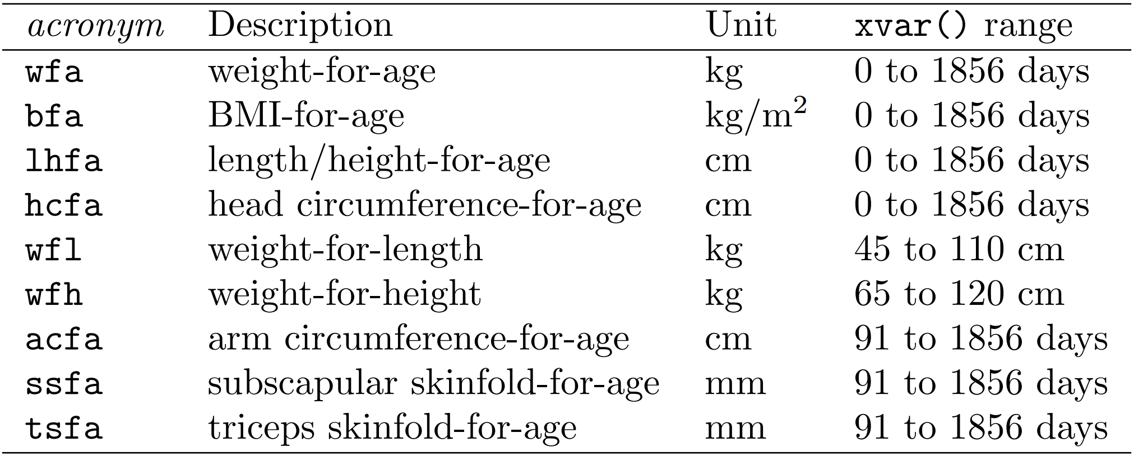
gigs | Conversion functions (who_gs())
egen [type] newvar = who_gs(varname, acronym, conversion) [if exp] [in range], xvar(varname)
sex(varname) sexcode(male=code, female=code)
The variable you want to perform conversions with (either measurements, or z-scores/percentiles)
An acronym in Table 1, denoting the WHO standard to convert in
The type of conversion to be performed: “v2z”, “v2p”, “z2v”, or “p2v”.
Provides x values to the function – the type of x depends on the standard in use
Informs the function of the sex of each observation. Should be in int, byte, or str.
Informs the function of how sex() is coded
Table 1: Acronyms, their meanings, and xvar() ranges for who_gs()
Notes:
The first function we’re going to look at, who ‘underscore’ GEE ESS, can convert between measurements and z-scores or percentiles in the WHO Child Growth Standards for children aged from zero to five years. The function generates a new variable newvar. We recommend storing your outputs as double-precision float, but this is your choice. The arguments to who ‘underscore’ GEE ESS are:
The variable you want to do conversions with,
followed by an acronym. These are shown in table one, and you can see how each different acronym refers to a different standard - for example “bfa” for the BMI for age standard.
Next comes the type of conversion you want to do. This can be converting values to z-scores or percentiles with vee two zed or vee two pee, or the reverse with zed two vee or pee to vee.
You can use the [if] and [in] portions to limit which observations the function returns a result for.
The xvar() option specifies x variables for each observation. Think of this as the ‘x’ you would have in a growth chart – usually for the WHO standards, this is age in days.
Finally, the sex() and sexcode() options provide information on the sex of each observation to the function. So, for a sex variable where 1 is male and 2 is female, you’d write sex code open bracket MALE equals 1 comma, female = 2). If 1 were female and 2 were male, you’d set male to 2 and female to 1.

Slide 12
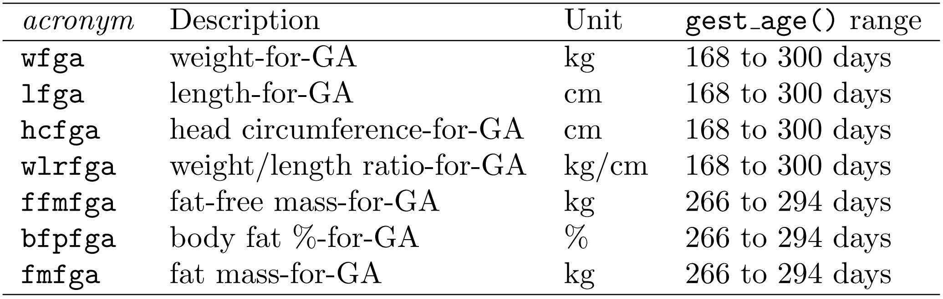
gigs | Conversion functions (ig_nbs())
egen [type] newvar = ig_nbs(varname, acronym, conversion) [if exp] [in range], gest_age(varname)
sex(varname) sexcode(male=code, female=code)
The variable you want to perform conversions with (either measurements, or z-scores/percentiles)
An acronym in Table 2 denoting the INTERGROWTH-21st NBS standard to convert in
The type of conversion to be performed: “v2z”, “v2p”, “z2v”, or “p2v”.
Provides values for gestational age in days to the function
Informs the function of the sex of each observation. Should be in int, byte, or str.
Informs the function of how sex() is coded
Table 2: Acronyms, their meanings, and gest_age() ranges for ig_nbs()
Notes:
The next function, ig underscore EN BEE ESS, performs conversions in the INTERGROWTH-21st standards for newborn size. The function is near identical to before, but instead of the xvar() option you use the gest underscore age option. This is because the INTERGROWTH-21st Newborn Size Standards always use gestational age as the x variable. You should supply this in days.

Slide 13
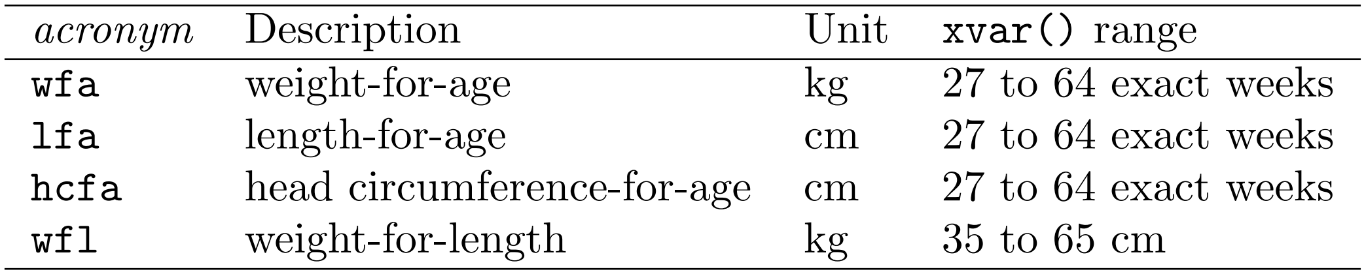
gigs | Conversion functions (ig_png())
egen [type] newvar = ig_png(varname, acronym, conversion) [if exp] [in range], xvar(varname)
sex(varname) sexcode(male=code, female=code)
The variable you want to perform conversions with (either measurements, or z-scores/percentiles)
An acronym in Table 3 denoting the INTERGROWTH-21st PNG standard to convert in
Provides x values to the function – the type of x depends on the standard in use
The type of conversion to be performed: “v2z”, “v2p”, “z2v”, or “p2v”.
Informs the function of the sex of each observation. Should be in int, byte, or str.
Informs the function of how sex() is coded
Table 3: Acronyms, their meanings, and xvar() ranges for ig_png()
Notes:
Our last conversion function covers postnatal growth in preterm infants and is therefore called ig underscore PEE EN GEE. Apart from the function name, its arguments are the same as the who_gs() function – except it takes different acronyms to the WHO standards.

Slide 14
gigs | Classification functions
Notes:
The gigs classification functions take a similar format.

Slide 15
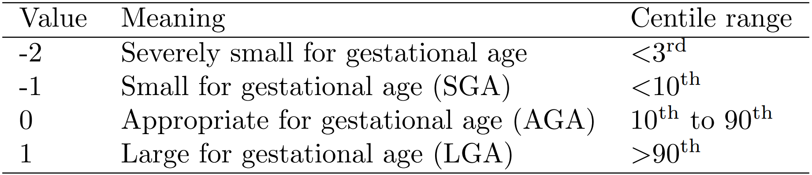
gigs | Classification functions (classify_sga())
egen [type] newvar = classify_sga(varname) [if exp] [in range], gest_age(varname)
sex(varname) sexcode(male=code, female=code)
A variable name for weight in kg, measured at birth
A variable denoting gestational age in days
Informs the function of the sex of each observation. Should be in int, byte, or str.
Informs the function of how sex() is coded
Table 4: Outputs and labels for classify_sga()
Notes:
The first, classify ESS GEE AY, uses weight at birth and the INTERGROWTH-21st newborn size standards to generate a variable with labels for size-for-gestational age categorisations. The cut-offs are given in table four.

Slide 16
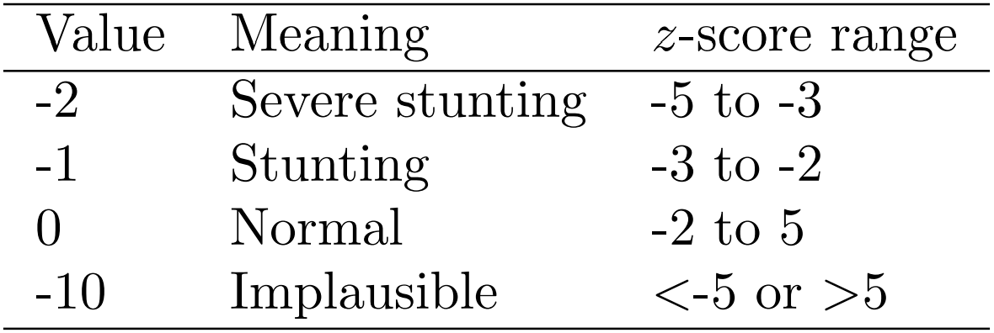
gigs | Classification functions (classify_stunting())
egen [type] newvar = classify_stunting(varname) [if exp] [in range], ga_at_birth(varname) age_days(varname)
lenht_method(varname) lenhtcode(length=code, height=code)
sex(varname) sexcode(male=code, female=code)
A variable denoting gestational age at birth in days
A variable name for length/height in cm
A variable denoting age in days
A variable denoting how length/height was recorded
Informs the function of how lenht_method() is coded
Informs the function of the sex of each observation. Should be in int, byte, or str.
Informs the function of how sex() is coded
Table 5: Outputs and labels for classify_stunting()
Notes:
The other three functions use the WHO and INTERGROWTH-21st standards to make z-scores in either length-for-age, weight-for-length/height, and weight-for-age. These z-scores can then be categorised according to existing cut-offs from the literature. The first classifies stunting, which is being too short for age. You provide the function with length/height in cm, the gestational age at birth in days for each observation, and the age in days. You also have to tell the function whether length or height was measured in each observation. This is because the length and height measurement processes are different, so the function might correct some values based on which type of measurement was taken. Finally, you provide the function with information on sex.

Slide 17
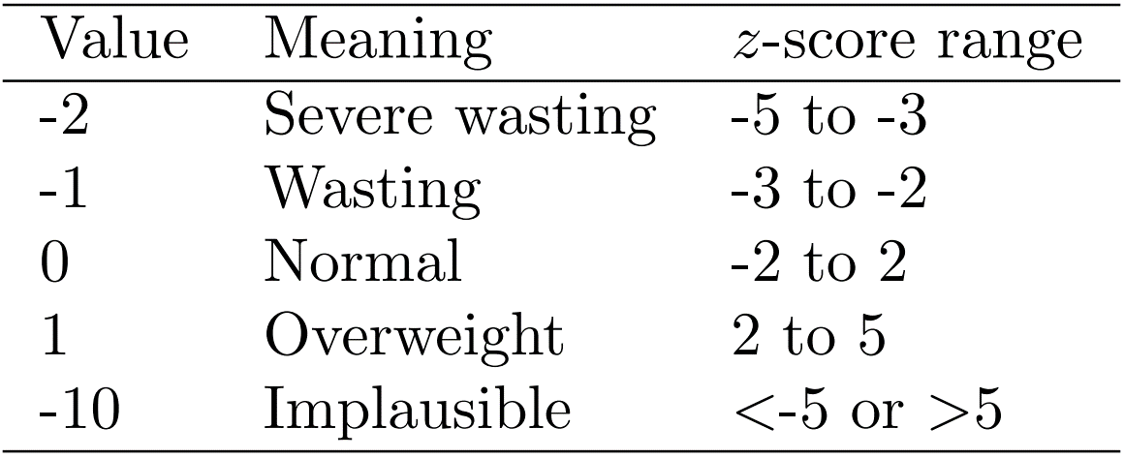
gigs | Classification functions (classify_ wasting())
egen [type] newvar = classify_wasting(varname) [if exp] [in range], lenht_cm(varname) lenht_method(varname)
lenhtcode(length=code, height=code)
sex(varname) sexcode(male=code, female=code)
A variable denoting how length/height was recorded
A variable name
for weight in kg
A variable with values for length/height in cm
Informs the function of how lenht_method() is coded
Informs the function of the sex of each observation. Should be in int, byte, or str.
Informs the function of how sex() is coded
Table 6: Outputs and labels for classify_wasting()
Notes:
The function for classifying wasting – that is, weighing too little for your length or height - has the same syntax as the previous function but omits the gestational age at birth option.

Slide 18
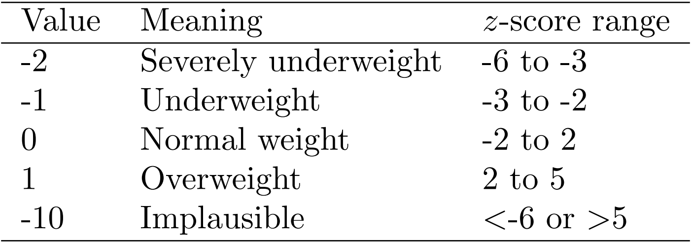
gigs | Classification functions (classify_wfa())
egen [type] newvar = classify_wfa(varname) [if exp] [in range], ga_at_birth(varname) age_days(varname)
sex(varname) sexcode(male=code, female=code)
A variable denoting gestational age at birth in days
A variable denoting age in days
A variable name for weight in kg
Informs the function of the sex of each observation. Should be in int, byte, or str.
Informs the function of how sex() is coded
Table 7: Outputs and labels for classify_wfa()
Notes:
The last classification function, classify weight-for-age, uses the gestational age at birth option, but does not include the length options from the earlier functions. It classifies whether infants are under or overweight, which is of importance in tracking both malnutrition and development of obesity.

Slide 19
gigs | The demonstration section
Notes:
[drop out of ppt into Stata, and run code there]
First, we’ll install gigs from Github using the Github module.
Now that that’s done, let’s load in an example dataset. This small example DTA-file contains a variable with percentiles, a variable with gestational ages, and a variable with sex. First, to show you that GIGS can convert between measurements and z-scores/percentiles and back again, we’ll convert the `perc` variable to weights in kg in the INTERGROWTH Newborn Size Standards.
So we get out this nice variable for weights in kg. Let’s now use the ig EN BEE ESS function to convert these weights back into percentiles – and as you can see, they’re the same as our original inputs! Finally, we’ll get size-for-gestational age categorisations using these weight values we generated. If you recall the cut-offs from before, you’ll note that the categorisations are correct.
Now for our next example:
This dataset contains z-scores, sexes, and age in days – as well as gestational ages and whether each infant was recorded using length or height. We can generate expected length/height values using the who_gs() conversion command:
These lengths and heights look reasonable. If we perform the conversion the other way, the results are again identical to the z-scores we used at the start. Now we can classify stunting for each observation, providing the function with the gestational age at birth, the age in days, whether length or height was taken for each observation and finally, sex information. Again, we get a variable with classifications for each variable, though this time for stunting.
As you can see, gigs makes using these growth standards easy and accessible for Stata users.

Slide 20



gigs | Looking forwards
On functional stability:
gigs classification functionality may change as we work on our guidance.
Stata package
    Optimisation
    Availability via SJ
R package
    Availability in GitHub/CRAN
Notes:
With the demonstrations out of the way, it’s time to wrap up.
Looking forwards, we hope to optimise the Stata package – an endeavour for which we would love to hear from anyone interested in looking over our .ado files. We also writing a manuscript up for the Stata Journal, such that the package is available via the `net install` command. We’re also working on our packages in other softwares, which are to be publicised in the future, and our guidance and web platform. We’d like to note that gigs is in development – the classification functions may change slightly as we iron out with collaborators exactly how each function should operate. That said, I can reassure you that the broad functionality of the package is stable at this point.

Slide 21




Dr Linda Vesel
Dr Eric Ohuma
  Get in contact:
  Email me at simon.parker@lshtm.ac.uk
Bancy Ngatia
Notes:
So, to wrap up: I would like to thank the Bill and Melinda Gates Foundation for funding this work, and my colleagues Eric, Linda, and Bancy for their work on this project - specifically the guidance I’ve received from both Eric and Linda whilst writing this package out. I would also like to thank you all for listening today and am very happy to take your questions.

