Slide 1
Implementing treatment-selection rules for multi-arm multi-stage (MAMS) trials using Stata’s nstage commands
Babak Choodari-Oskooei
Alexandra Blenkinsop, Mahesh KB Parmar
MRC Clinical Trials Unit at UCL
Institute of Clinical Trials & Methodology, University College London
UK Stata Conference | London 12-13 September 2023

Slide 2
Outline
Introduction to standard multi-arm multi-stage (MAMS) designs
MAMS selection designs
ROSSINI-2 trial example: Surgery ( to prevent surgical wound infection)
Sample size and operating characteristics of MAMS selection designs
Update to nstagebin command
Summary

Slide 3



Multi-Arm Multi-Stage (MAMS) designs
Methods by Royston et al. (2003)
  For time-to-event outcomes
Context: Randomised clinical trials
  Efficacy and safety of new interventions in a defined population
Control of operating characteristics are important
  Probability of false positive (Type I error)
    Of interest to regulators and reviewers
  Probability of true positive (Power)
    Of interest to funders
Multiple research arms vs a common control arm
MAMS design has many advantages and challenges
Control
E1
E2
E3
E4
E5
E6
E7
Stage 1
Stage 2
Stage 3
Notes:
- Now we focus in on the particular class of MAMS design under consideration
- Methods for a multi-arm 2-stage design were developed in the early 2000s and later extended to the multi-stage setting
- Developed for time-to-event outcomes with applications in cancer trials
- Later extended to trials with binary outcomes
- Targets late phase/confirmatory trials – most costly phase of testing
- Makes pairwise comparisons between multiple research arms and 1 common control arm – no direct head to head comparisons of research arms
- Permits the use of an intermediate outcome measure which is correlated with definitive/primary outcome but can be observed earlier to allow trigger interim analyses early on in trial
- This int/I-outcome could be composite including primary outcome e.g. FFS/PFS an intermediate outcome for OS
- Early interim analyses allow us to drop arms mid-trial if they do not demonstrate sufficient benefit against the control arm (LOB assessment)
- Such a design is denoted $I≠D$ to indicate the intermediate outcome differs from the definitive outcome
- I=D correspondingly denotes a design in which the same outcome measure is used throughout

Slide 4
Example: ROSSINI-2 MAMS trial in surgery

Slide 5
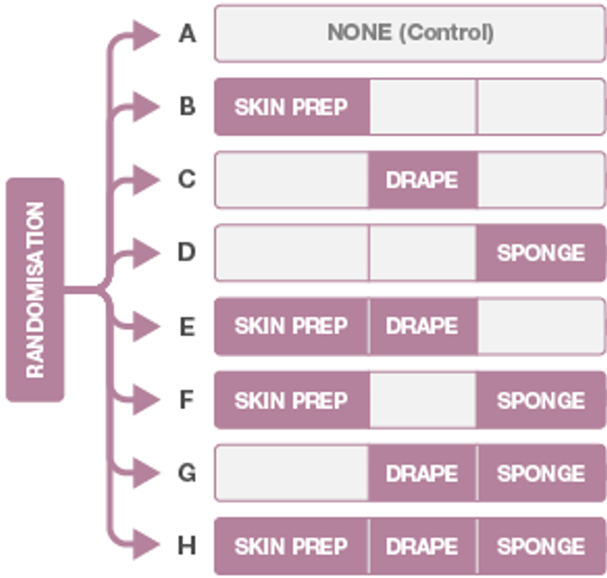
Example: ROSSINI-2 MAMS design
8-arm 3-stage trial in surgery
  i.e. 7 pairwise comparisons
Clinical outcome composite binary,
  Surgical site infection (SSI) within 4 weeks
  Same outcome used in all stages
*) FWER is strongly controlled using Dunnett’s probability/correction.
Primary design parameters | Value
Overall type I error rate (FWER*) | 0.025 (one-sided)
Overall pairwise power | 0.85
Control arm event rate | 15%
Target effect size (reduction) | 5% (reduction from Ctrl. arm event rate)
5

Slide 6

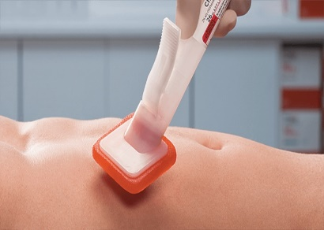
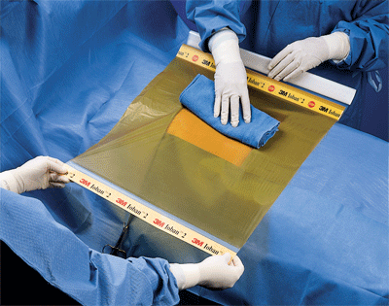
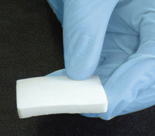
Example – the surgical trial
8-arm 3-stage surgical trial
Clinical outcome: composite binary, surgical site infection (SSI);
Main interventions
A) Chlorhexidine 2% alcoholic skin prep [versus any other standard wound prep agent of surgeon’s choice]
B) Loban-impregnated incise drapes [versus no drape]
C] Gentamicin-impregnated collagen sponge [versus no sponge]
6

Slide 7
Two steps to design such study
Step 1: Find stagewise design significance levels and power given prespecified overall operating characteristics:
  Control the overall type I rate (FWER) and power
  Consider available information about the effectiveness of treatments
  nstagebinopt Stata command
  Choodari-Oskooei et al. (2023), DOI:https://doi.org/10.1177/1536867X231196295
Step 2: Conduct sample size calculations and estimate the trial timelines, using the design parameters found in Step 1.
  nstagebin Stata command

Slide 8
nstagebinopt command for designs
Syntax:
nstagebinopt, alpha(0.025) power(0.85) fwer nstage(3) arms(8) theta0(0) theta1(-0.05) ctrlp(0.15) ltfu(0.04) fu(4) accrate(118 248 248) aratio(0.5) plot
Aim to control of the FWER
Remove if aim is to control
pairwise error rate (PWER)
Notes:
Program searches for optimal/admissible designs and outputs them as a table.

Slide 9
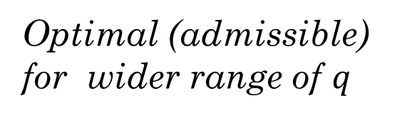
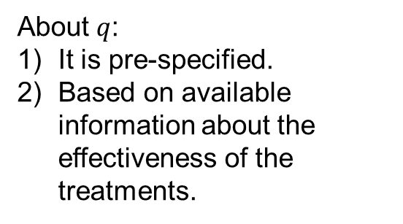
nstagebinopt output
About $q$:
It is pre-specified.
Based on available information about the effectiveness of the treatments.
n-stage (binary) trial design version 1.0.2, 09 June 2023
---------------------------------------------------------------------------------
Admissible designs for a 8-arm 3-stage trial with binary outcome based on
Choodari-Oskooei, Bratton, and Parmar (2023) Stata Journal 23(3).
---------------------------------------------------------------------------------
Design q-range Stage Sig. Power Alloc. E(N|H0) E(N|H1) FWER
number level ratio (SE)
---------------------------------------------------------------------------------
1 [0.00,0.09] 1 0.31 0.93 0.50 4658 8667 0.0249
2 0.16 0.93 (0.0003)
3 0.005 0.92
---------------------------------------------------------------------------------
2 [0.10,0.65] 1 0.40 0.94 0.50 4683 8437 0.0253
2 0.14 0.94 (0.0003)
3 0.005 0.91
---------------------------------------------------------------------------------
3 [0.66,0.77] 1 0.15 0.93 0.50 4989 8277 0.0254
2 0.08 0.93 (0.0003)
3 0.005 0.90
---------------------------------------------------------------------------------
4 [0.78,1.00] 1 0.27 0.99 0.50 6506 7824 0.0253
2 0.14 0.99 (0.0003)
3 0.004 0.85
---------------------------------------------------------------------------------
Note: each design minimises the loss function (1-q)E(N|H0)+qE(N|H1) for values of
q specified in q_range. H1 is the hypothesis that all of the experimental
arms are effective.
Optimal (admissible) for wider range of $q$
Loss function used in nstagebinopt
Notes:
Program searches for optimal/admissible designs and outputs them as a table.

Slide 10
8-arm 3-stage optimal standard MAMS design
Stage | Sig. level (One-sided) | Analysis | Design power | Overall Sample size | Duration (months)
1 | 0.40 | Lack-of-benefit | 0.94 | 2358 | 20
2 | 0.14 | Lack-of-benefit | 0.94 | 4995 | 31
3 | 0.005 | Efficacy | 0.91 | 8847 | 50
Overall | 0.025* |  | 0.85**
Sample size for funding application.
*) Familywise type I error rate (FWER), calculated using Dunnett’s probability
**) Overall pairwise power as defined by Royston et al. (2003)
Note:
Sample size: if we run the same trial as separate 7 two-arm trials: 11,396 (7*1628)
  The FWER across 7 two-arm trials is 0.16, 1-(1-0.025)^7
***) nstagebin, alpha(0.40 0.14 0.005) power(0.94 0.94 0.91) nstage(3) theta0(0) theta1(-0.05) ctrlp(0.15) arms(8 8 8) ltfu(0.04) fu(4) accrate(118 248 248) aratio(0.5) tunit(4) ess
Notes:
Trials were redesigned as seamless phase II/III two-arm multi-stage trials to see if savings in time and resources could be made using this approach
An estimate of the PPV was obtained from a meta-analysis by Horne et al. (PPV=95%)
Seamless two-arm multi-stage designs give huge savings in sample size and time even with gains in power
Savings that can be made in a multi-arm multi-stage trial compared to separate two-arm trials will therefore be vast
Adding extra intermediate stages slightly reduces power but also reduces chance of continuing ineffective arms to the final stage
Lower sig. level can therefore be used in final stage thus reducing the maximum sample size

Slide 11
8-arm 3-stage optimal standard MAMS design
Stage | Sig. level (One-sided) | Analysis | Design power | Overall Sample size | Duration (months) | ESS E(N|H0) | ESS E(N|H1)
1 | 0.40 | Lack-of-benefit | 0.94 | 2358 | 20
2 | 0.14 | Lack-of-benefit | 0.94 | 4995 | 31
3 | 0.005 | Efficacy | 0.91 | 8847 | 50
Overall | 0.025* |  | 0.85** |  |  | 4683 |  | 8437
*) Familywise type I error rate (FWER), calculated using Dunnett’s probability
**) Overall pairwise power as defined by Royston et al. (2003)
Note:
Sample size: if we run the same trial as separate 7 two-arm trials: 11,396 (7*1628)
  The FWER across 7 two-arm trials is 0.16, 1-(1-0.025)^7
***) nstagebin, alpha(0.40 0.14 0.005) power(0.94 0.94 0.91) nstage(3) theta0(0) theta1(-0.05) ctrlp(0.15) arms(8 8 8) ltfu(0.04) fu(4) accrate(118 248 248) aratio(0.5) tunit(4) ess
Notes:
Trials were redesigned as seamless phase II/III two-arm multi-stage trials to see if savings in time and resources could be made using this approach
An estimate of the PPV was obtained from a meta-analysis by Horne et al. (PPV=95%)
Seamless two-arm multi-stage designs give huge savings in sample size and time even with gains in power
Savings that can be made in a multi-arm multi-stage trial compared to separate two-arm trials will therefore be vast
Adding extra intermediate stages slightly reduces power but also reduces chance of continuing ineffective arms to the final stage
Lower sig. level can therefore be used in final stage thus reducing the maximum sample size

Slide 12
Standard MAMS designs
Many research arms may pass the interim stages
  In fact, they all reach the final stage if all interventions are effective
Maximum sample size can be too large to achieve, or for funding agencies to fund it.
Control
E1
E2
E3
E4
E5
E6
E7
Stage 1
Stage 2
Stage 3

Slide 13
MAMS selection designs
Pre-specify a subset of arms that are allowed to continue to next stage(s).
  This provides a ceiling on sample size,
  Simplifies planning,
  Shortens the trial timelines and reduces costs.
Pre-specify a selection rule at design stage
  E.g., in a 8-arm 3-stage design, the rule might be 7:5:3
Selection based on relative performance of arms
  i.e., those with highest estimated treatment effects.
Control
E1
E2
E3
E4
E5
E6
E7
Stage 1
Stage 2
Stage 3

Slide 14
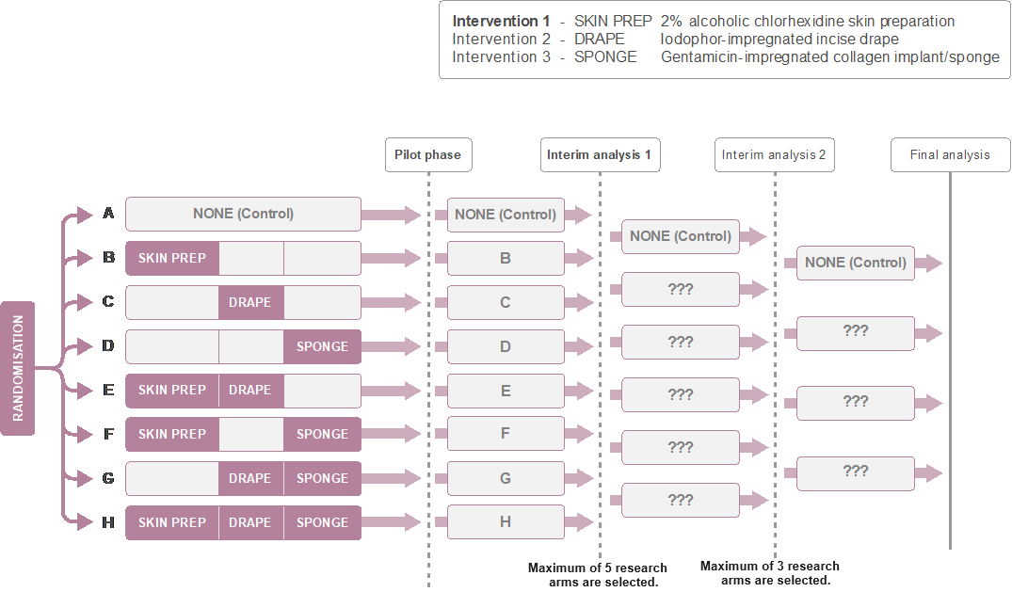
ROSSINI 2: 8-arm 3-stage MAMS selection design
Selection rule is 7:5:3.
Includes lack-of-benefit rules, as well.
Ref: Choodari-Oskooei, et al. (2024): 10.1186/s12874-024-02247-w
Notes:
Motivating example for implementing this methods
ROSSINI 2 is a phase III MAMS trial investigating interventions to prevent surgical site infection following abdominal surgery
3 interventions, applied alone and in combination (7 research arms, control = no intervention)
2 interim analyses planned, where the primary outcome will be assessed on each arm according to the pre-specified stopping rules and any arms not demonstrating sufficient benefit will be stopped
It has also been decided that the trial will guarantee to stop 2 research arms at each analysis, as a means of controlling resources and aiding planning – scheduled at around a 1/5 and ½ way through trial
Requires mechanism for determining which to select

Slide 15
nstagebin for sample size calculations
Syntax for the standard MAMS design:
nstagebin, alpha(0.40 0.14 0.005) power(0.94 0.94 0.91) nstage(3) theta0(0) theta1(-0.05) ctrlp(0.15) arms(8 6 4) ltfu(0.04) fu(4) accrate(118 248 248) aratio(0.5) tunit(4) ess selection
Note the input values in
arms() option
Selection rule is 7:5:3
Notes:
Program searches for optimal/admissible designs and outputs them as a table.

Slide 16
MAMS selection design: nstagebin output
Output has 2 main sections
Section 1
n-stage trial design - binary outcome version 1.0.3, 09 Sep 2024
-----------------------------------------------------------------------
Sample size for a 8-arm 3-stage trial with binary outcome based on
Bratton et al. (2013) BMC Med Res Meth 13:139 and Choodari-Oskooei,
Bratton, and Parmar (2023) Stata Journal 23(3).
-----------------------------------------------------------------------
Control arm event rate = 0.15
Delay in observing outcome = 4 months
Attrition rate for outcome = 0.04
MAMS selection design: Select best 5 3 arms at stages 1-2
Operating characteristics
-----------------------------------------------------------------------------
Alpha(1S) Power theta|H0 theta|H1 Length* Time*
-----------------------------------------------------------------------------
Stage 1 0.4000 0.940 0.000 -0.050 19.979 19.979
Stage 2 0.1400 0.940 0.000 -0.050 9.165 29.144
Stage 3 0.0050 0.910 0.000 -0.050 11.994 41.138
Pairwise 0.0039 0.849** 41.138
FWER (SE) 0.0251 (0.0003)
-----------------------------------------------------------------------------
* Length (duration of each stage) is expressed in month periods
** Overall power
FWER is calculated using simulations with 250000 replications
Notes:
Program performs sample size calculations and produces easy-to-interpret output with sample size per stage and operating characteristics

Slide 17
MAMS Selection design: nstagebin output
Cumulative sample sizes per arm per stage
---------Stage 1---------
Overall Control Exper.
------------------------------------------------
Number of active arms 8 1 7
Accrual rate* 118.0 26.2 91.8
Active arms
Patients for analysis 1809 402 201
Patients recruited** 2358 524 262
All arms
Patients recruited** 2358
------------------------------------------------
---------Stage 2---------
Overall Control Exper.
------------------------------------------------
Number of active arms 6 1 5
Accrual rate* 248.0 70.9 177.1
Active arms
Patients for analysis 2989 854 427
Patients recruited** 4108 1173 587
All arms
Patients recruited** 4632
------------------------------------------------
---------Stage 3---------
Overall Control Exper.
------------------------------------------------
Number of active arms 4 1 3
Accrual rate* 248.0 99.2 148.8
Active arms
Patients for analysis 4719 1887 944
Patients recruited** 4915 1966 983
All arms
Patients recruited** 6613
------------------------------------------------
Expected sample size | 0 effective arms = 4610
Expected sample size | 7 effective arms = 6486
Section 2
Notes:
Program performs sample size calculations and produces easy-to-interpret output with sample size per stage and operating characteristics

Slide 18
ROSSINI 2 8-arm 3-stage MAMS selection design:
Selection rule: 7:5:3
Stage | Sig. level (One-sided) | Analysis | Design power | Max no of research arms | Overall Sample size | Duration (months)
1 | 0.40 | Lack-of-benefit | 0.94 | 7 | 2358 | 20
2 | 0.14 | Lack-of-benefit | 0.94 | 5 | 4632 | 29
3 | 0.005 | Efficacy | 0.91 | 3 | 6613 | 41
Overall | 0.025* |  | 0.85**
*) Familywise type I error rate (FWER), calculated using Dunnett’s probability
Note:
Sample size: if we run the same trial as separate 7 two-arm trials: 11,396 (7*1628)
  The FWER across 7 two-arm trials is 0.16, 1-(1-0.025)^7
***) nstagebin, alpha(0.40 0.14 0.005) power(0.94 0.94 0.91) nstage(3) theta0(0) theta1(-0.05) ctrlp(0.15) arms(8 6 4) ltfu(0.04) fu(4) accrate(118 248 248) aratio(0.5) tunit(4) ess sel
Notes:
Trials were redesigned as seamless phase II/III two-arm multi-stage trials to see if savings in time and resources could be made using this approach
An estimate of the PPV was obtained from a meta-analysis by Horne et al. (PPV=95%)
Seamless two-arm multi-stage designs give huge savings in sample size and time even with gains in power
Savings that can be made in a multi-arm multi-stage trial compared to separate two-arm trials will therefore be vast
Adding extra intermediate stages slightly reduces power but also reduces chance of continuing ineffective arms to the final stage
Lower sig. level can therefore be used in final stage thus reducing the maximum sample size

Slide 19

Considerations when choosing MAMS selection designs?
How to select after stage 1?
How many to select?
When to select?
Link:
https://doi.org/10.1186/s12874-024-02247-w
We will come back to these questions!

Slide 20
MAMS trials in postpartum haemorrhage (PPH)
Globally, PPH is the leading cause of maternal deaths with ~70,000 every year,
  One woman dying from PPH every 8 minutes
  Particularly in sub-Saharan Africa PPH is responsible for 25% of deaths
The RED trial investigates the clinical efficacy of 3 different devices against control.
  Clinical outcome: composite binary
  A 4-arm (MAMS) trial
Two devices are almost identical with a very minor difference in their mechanism.
    Control arm
    Research arm 1: UBT Ellavi, fixed-volume
    Research arm 2: UBT Ellavi, free-flow
    Research arm 3: USD
familywise error rate control
(2.5%, one-sided)

Slide 21
MAMS trials in PPH
Compared with 3 two-arm trials:
No | Design⁽¹⁾ | Type I error rate Control (value) | Final stage Sig. level (one-sided) | Power | Total/max. SS
1 | 3 two-arm trials | Pairwise (0.025) | 0.025 | 0.80 | 4200
2 | 4-arm MAMS trial⁽²⁾ | Familywise (0.025) | 0.009⁽³⁾ | 0.80 | 3200
1) Targeting effect size of 1/3 reduction in risk, with near optimal allocation ratio.
2) Design with interim lack-of-benefit rules.
3) Note the final analysis sig. level: 0.009 (used Dunnett’s correction)

Slide 22
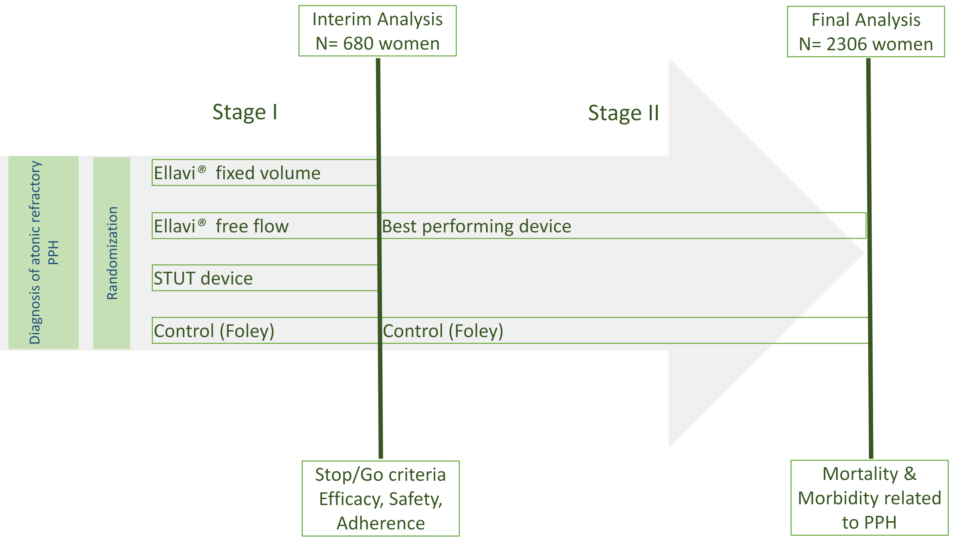
RED MAMS selection trial
Selection rule: 3:1
Selection stage
Stage 2
Device 1
Device 2
Device 3
Control
Control

Slide 23
RED MAMS selection trial in PPH
MAMS selection and full MAMS designs:
No | Design⁽¹⁾ | Type I error rate Control | Final stage Sig. level | Power | Total/max. SS
1 | 3 two-arm trials | Pairwise (0.025) | 0.025 | 0.80 | 4200
2 | 4-arm MAMS trial | Familywise (0.025) | 0.009 | 0.80 | 3200
3 | MAMS selection design | Familywise (0.025) | 0.015 | 0.78 | 2300
1) Targeting effect size of 1/3 reduction in risk, with near optimal allocation ratio.

Slide 24
Summary
Consider MAMS selection designs when there is clear and strict limit:
  on the number of individuals that can be recruited,
  funds available to support trial,
  timeline for trial.
MAMS designs allow for both treatment selection and interim stopping boundaries for lack-of-benefit.
  Both rules are prespecified,
MAMS selection designs can produce maximum sample size savings of up to 25% compared to the optimal (standard) MAMS design and by more than 40% compared with multiple 2-arm trials.
nstagebin Stata command allow for prespecified treatment selection and lack-of-benefit rules:
  Used to design MAMS selection trials in a range of disease area, including:
    Cancer, surgery, maternal health, fertility, maternal health, dermatology, …
Notes:
MAMS designs can greatly increase the rate at which new treatments are evaluated by
Incorporating phase 2 and 3 into a single trial
Assessing multiple new treatments vs a common control
Ceasing recruitment to arms which are showing no effect during the trial

Slide 25
Acknowledgements
Thanks to:
  Alexandra Blenkinsop (Imperial College London)
  Daniel Bratton (GSK)
  Ian White (UCL)
  Matthew Sydes (UCL)
  Max Parmar (UCL)
  Tom Pinkney (Birmingham University)
  Patrick Royston (UCL)
All the collaborators: particularly, those involved in ROSSINI-2 trial

Slide 26
References
Choodari-Oskooei, et al. (2024) Multi-arm multi-stage (MAMS) randomised selection designs: impact of treatment selection rules on the operating characteristics. BMC Medical Research Methodology 24(124). DOI: 10.1186/s12874-024-02247-w
Pinkney. 2023. https://fundingawards.nihr.ac.uk/award/NIHR156728
Choodari-Oskooei, et al. (2023) Facilities for optimizing and designing multi-arm multi-stage (MAMS) randomized controlled trials with binary outcomes. The Stata Journal; 23(3), 774–798. doi: https://doi.org/10.1177/1536867X231196295
Choodari-Oskooei, et al. (2023) Treatment selection in multi-arm multi-stage designs: With application to a postpartum haemorrhage trial. Clinical Trials. 20(1):71-80. DOI: 10.1177/17407745221136527
Choodari-Oskooei, et al. (2022) Multi-arm multi-stage (MAMS) platform randomized clinical trials. In: Principles and Practice of Clinical Trials. Springer. DOI: 10.1007/978-3-319-52677-5_110-1
Royston, et al. (2003) Novel designs for multi-arm clinical trials with survival outcomes with an application in ovarian cancer. Statistics in Medicine. 22:2239–2256. doi: 10.1002/sim.143

Slide 27
Thank you for your attention

Slide 28
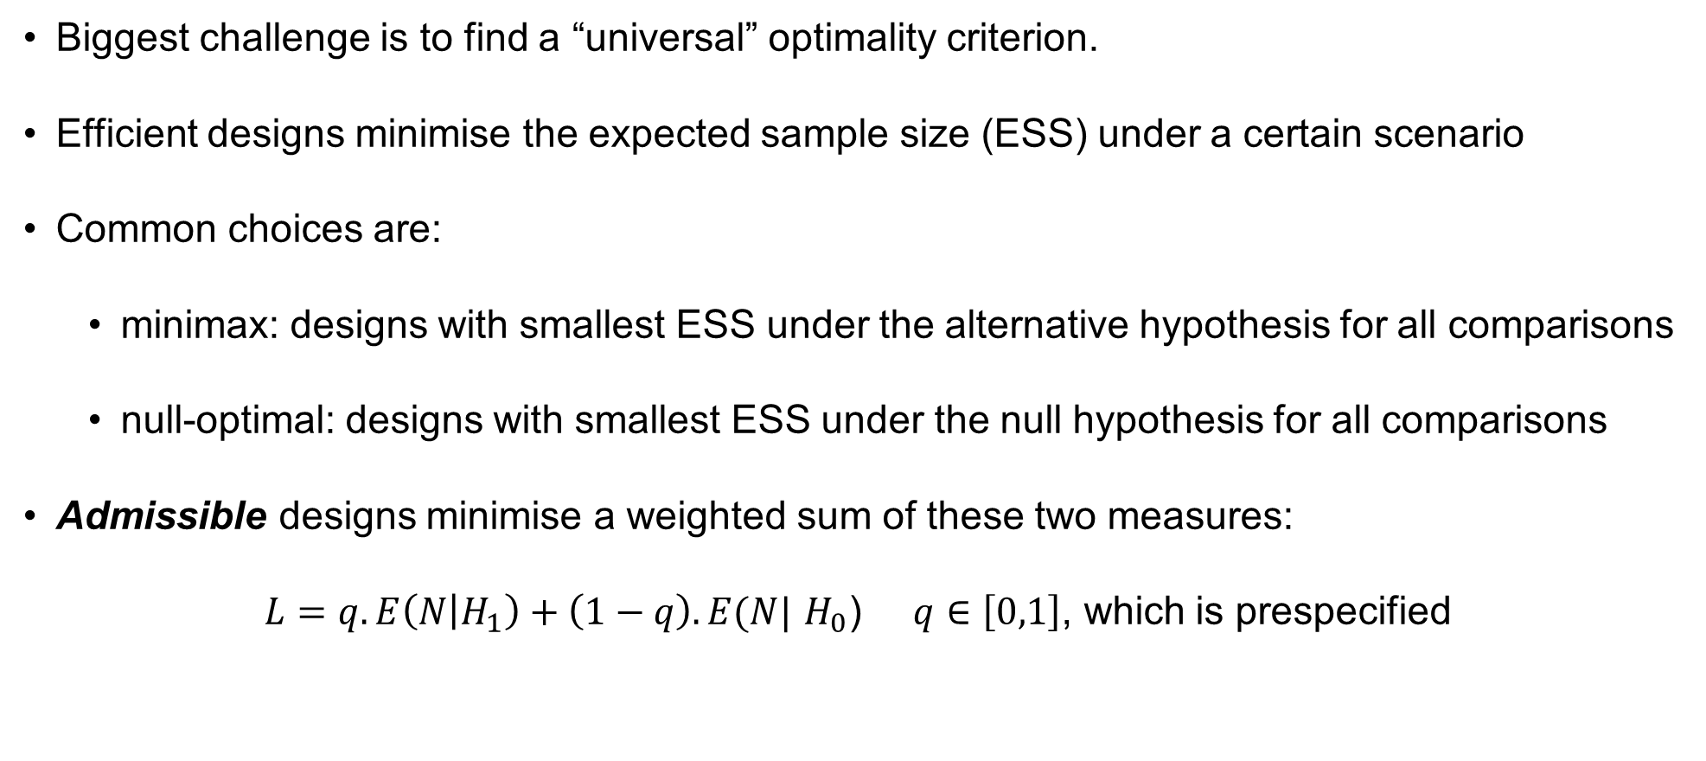
Step 1 leads us to optimal MAMS designs
Biggest challenge is to find a “universal” optimality criterion.
Efficient designs minimise the expected sample size (ESS) under a certain scenario
Common choices are:
  minimax: designs with smallest ESS under the alternative hypothesis for all comparisons
  null-optimal: designs with smallest ESS under the null hypothesis for all comparisons
Admissible designs minimise a weighted sum of these two measures:
$L=q. E\left(N | H_{1}\right)+\left(1−q\right).E(N|$ $H_{0}$) $q∈\left[0,1\right]$, which is prespecified
Loss function used in nstagebinopt
Notes:
Designs which minimise the expected sample size E(N) under a particular hypothesis (optimal design) are of interest

Slide 29
8-arm 3-stage null-optimal, minimax and admissible designs
Design* | Stage | Overall Type-1 error (FWER) (One-sided) | Overall power | Stage 1 Sample size | Stage 2 Sample size | Maximum Sample size | E(N|H₀) | E(N|H₁)
Null-optimal** (min. E(N|H₀)) | 3 | 0.025 | 0.85 | 2717 | 4509 | 9135 | 4658 | 8667
Minimax*** (min. E(N|H₁)) | 3 | 0.025 | 0.85 | 5454 | 7677 | 7847 | 6506 | 7824
Admissible | 3 | 0.025 | 0.85 | 2358 | 4995 | 8847 | 4683 | 8438
*) nstagebinopt, alpha(0.025) power(0.85) fwer nstage(3) arms(8) theta0(0) theta1(-0.05) ctrlp(0.15) ltfu(0.04) fu(4) accrate(118 248 248) aratio(0.5) plot
**) nstagebin, alpha(0.27 0.14 0.004) power(0.99 0.99 0.85) nstage(3) theta0(0) theta1(-0.05) ctrlp(0.15) arms(8 8 8) ltfu(0.04) fu(4) accrate(118 248 248) aratio(0.5) tunit(4) ess
***) nstagebin, alpha(0.31 0.16 0.005) power(0.93 0.93 0.92) nstage(3) theta0(0) theta1(-0.05) ctrlp(0.15) arms(8 8 8) ltfu(0.04) fu(4) accrate(118 248 248) aratio(0.5) tunit(4) ess

