Slide 1
siman: A suite of Stata programs for analysing simulation studies
Ella Marley-Zagar, Ian White, Tim Morris
e.marley-zagar@ucl.ac.uk
MRC Clinical Trials Unit at UCL
London Stata Conference
8 September 2022
Notes:
20 mins presentation slot to include questions

Slide 2
Introducing simulation studies and siman
Simulation studies are used in a variety of disciplines to evaluate the properties of statistical methods.
They are an important and useful tool which enables researchers to compare different statistical methods and understand their properties.
We introduce the siman suite which has been created to assist the analysis of simulation results.
A set of Stata programs that offer data manipulation, analysis and graphics to process, explore and visualise the results of simulation studies.

Slide 3
Plan of talk
The new siman program described here is available at https://github.com/UCL/simansuite
Simulation study set up: ADEMP
Types of data sets
Performance measures
Setting up siman
Exploring the estimates data
Creating performance measures and graphs
Software testing
Discussion

Slide 4
Simulation study set up: ADEMP
In a simulation study, data is generated from a known distribution (so that we know the ‘truth’), the data is analysed and then compared with the known truth.
The ADEMP Framework can be used:
Aim(s): the question(s) the simulation study is designed to address.
Data-generating Mechanism(s), DGM(s): Sets out how the simulated data will be created.
Estimand(s): Also called target. Sets out what quantity the analysis is trying to estimate.
Method(s): Sets out how each simulated data set will be analysed to give an estimate of the estimand.
Performance Measure(s)

Slide 5
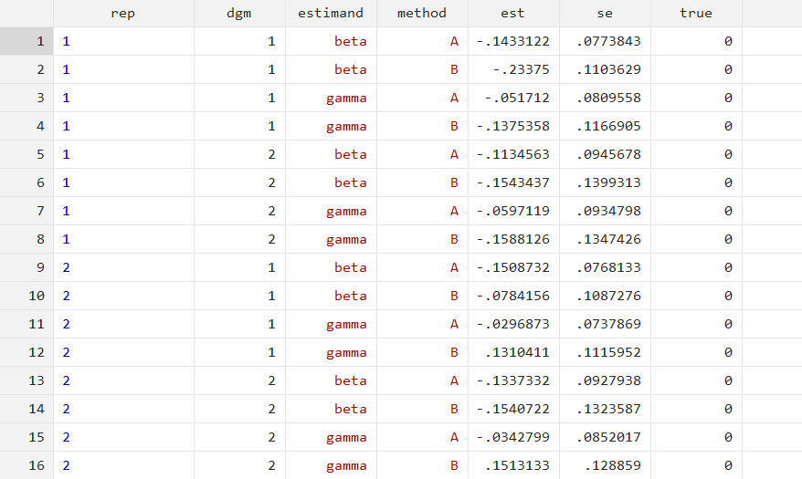
Types of Data Sets: INPUT Estimate Data
Estimates data set: results from analysing multiple simulated data sets, with data relating to different statistics (e.g. point estimate (est), se) for each simulated data set.
repetition (rep): simulation number

Slide 6
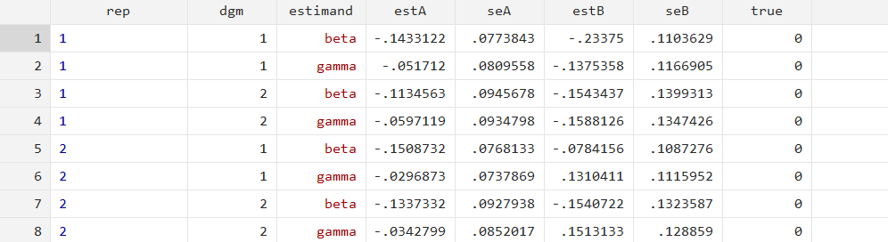
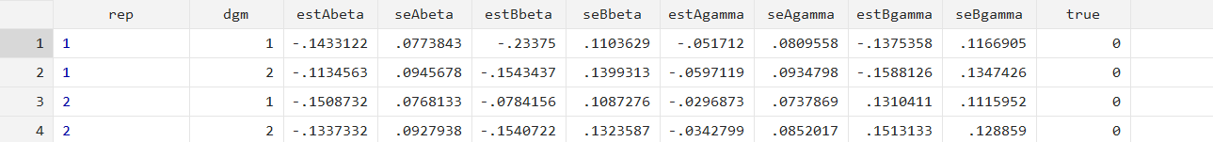
Types of Data Sets: Long and Wide
For the input estimates data, there are 3 formats permitted by the siman suite:
Long for both targets and methods: longlong
Wide for both target and methods : widewide
Long for targets, wide for methods : longwide

Slide 7
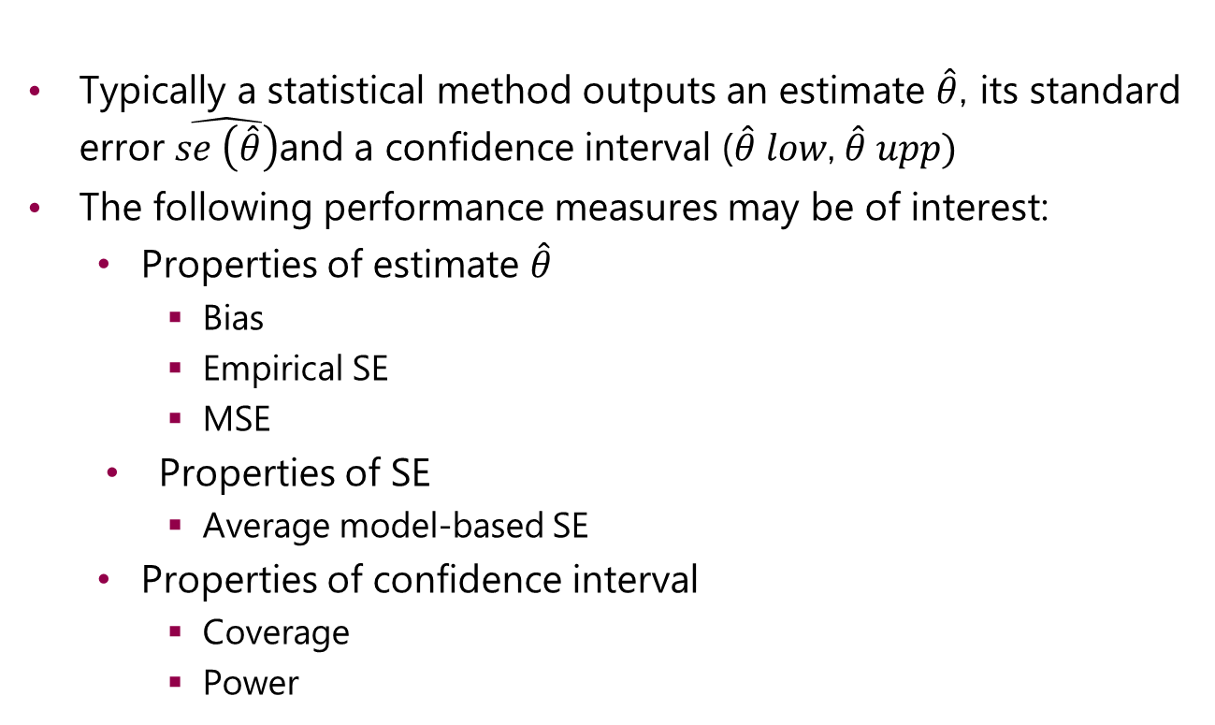
Performance Measures
Typically a statistical method outputs an estimate $\hat{θ}$, its standard error $\hat{se \left(\hat{θ}\right)}$and a confidence interval ($\hat{θ}$𝑙𝑜𝑤, $\hat{θ}$𝑢𝑝𝑝)
The following performance measures may be of interest:
  Properties of estimate $\hat{θ}$
    Bias
    Empirical SE
    MSE
  Properties of SE
    Average model-based SE
  Properties of confidence interval
    Coverage
    Power

Slide 8
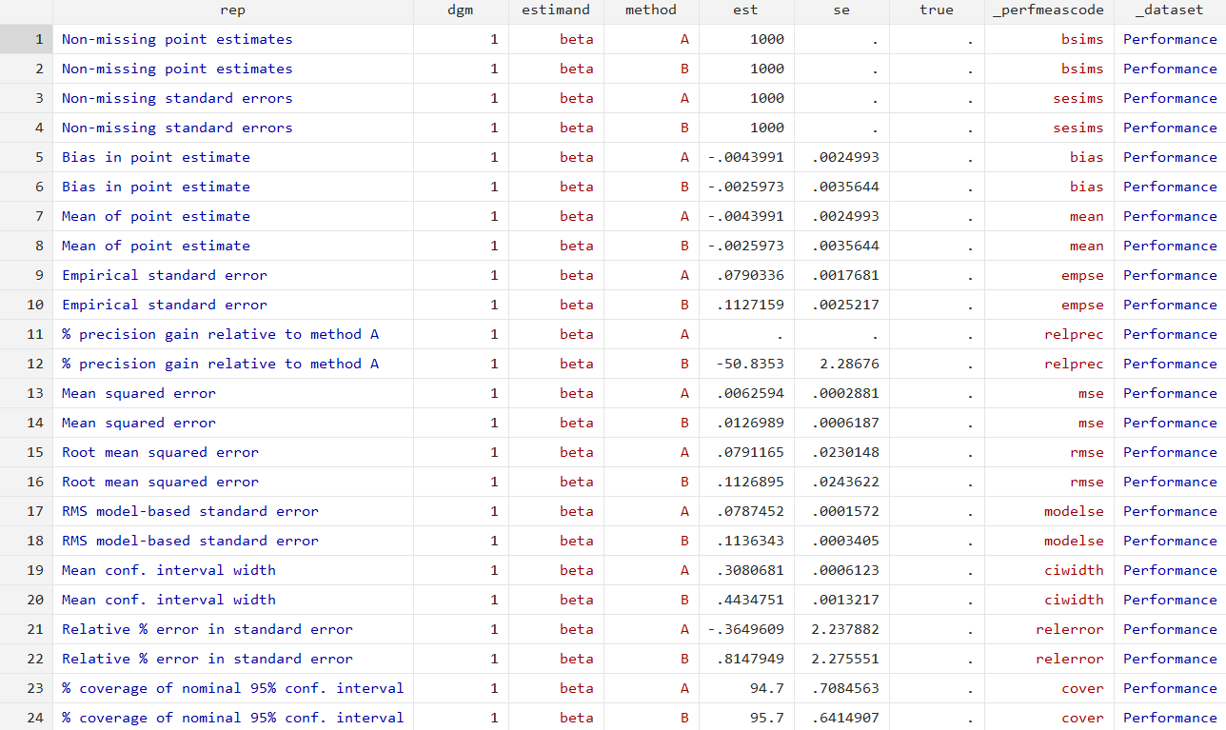
Types of Data Sets: OUTPUT Performance Measures
Performance measures data set: results from analysing an estimates data set, with data relating to different performance measures (e.g. bias, coverage) summarised over estimates data sets for different data generating mechanisms.

Slide 9
Setting up siman: long-long format
siman setup takes the estimates data set held in memory, checks the data, reformats it if necessary and attaches characteristics to the data set available for use across multiple sessions.
siman setup, rep(rep) dgm(dgm) target(estimand)
method(method) est(est) se(se) true(true)

Slide 10
Setting up siman: wide-wide format
siman setup, rep(rep) dgm(dgm) target(beta gamma)
method(A B) est(est) se(se) true(true) order(method)

Slide 11
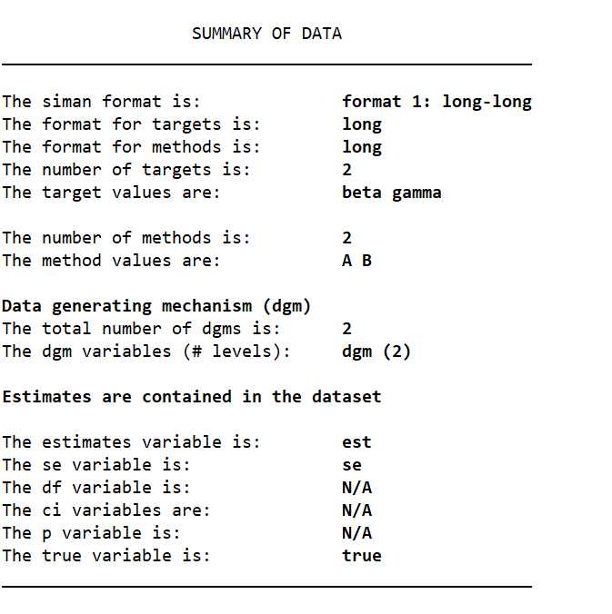
Setting up siman: siman describe

Slide 12
Exploring the estimates data: siman reshape
siman reshape, longlong
siman reshape, longwide

Slide 13
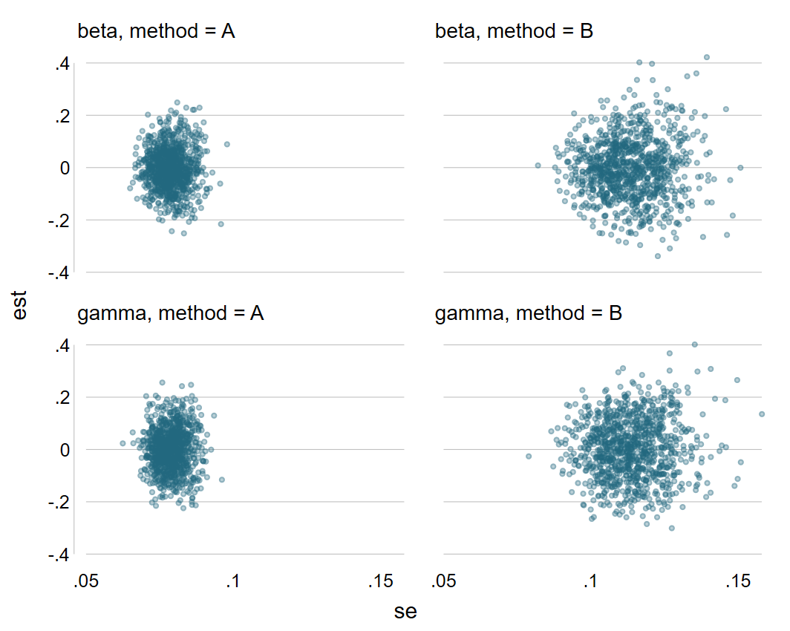
Exploring the estimates data: siman scatter
siman scatter [if] [in] [, options]
siman scatter if dgm == 1

Slide 14
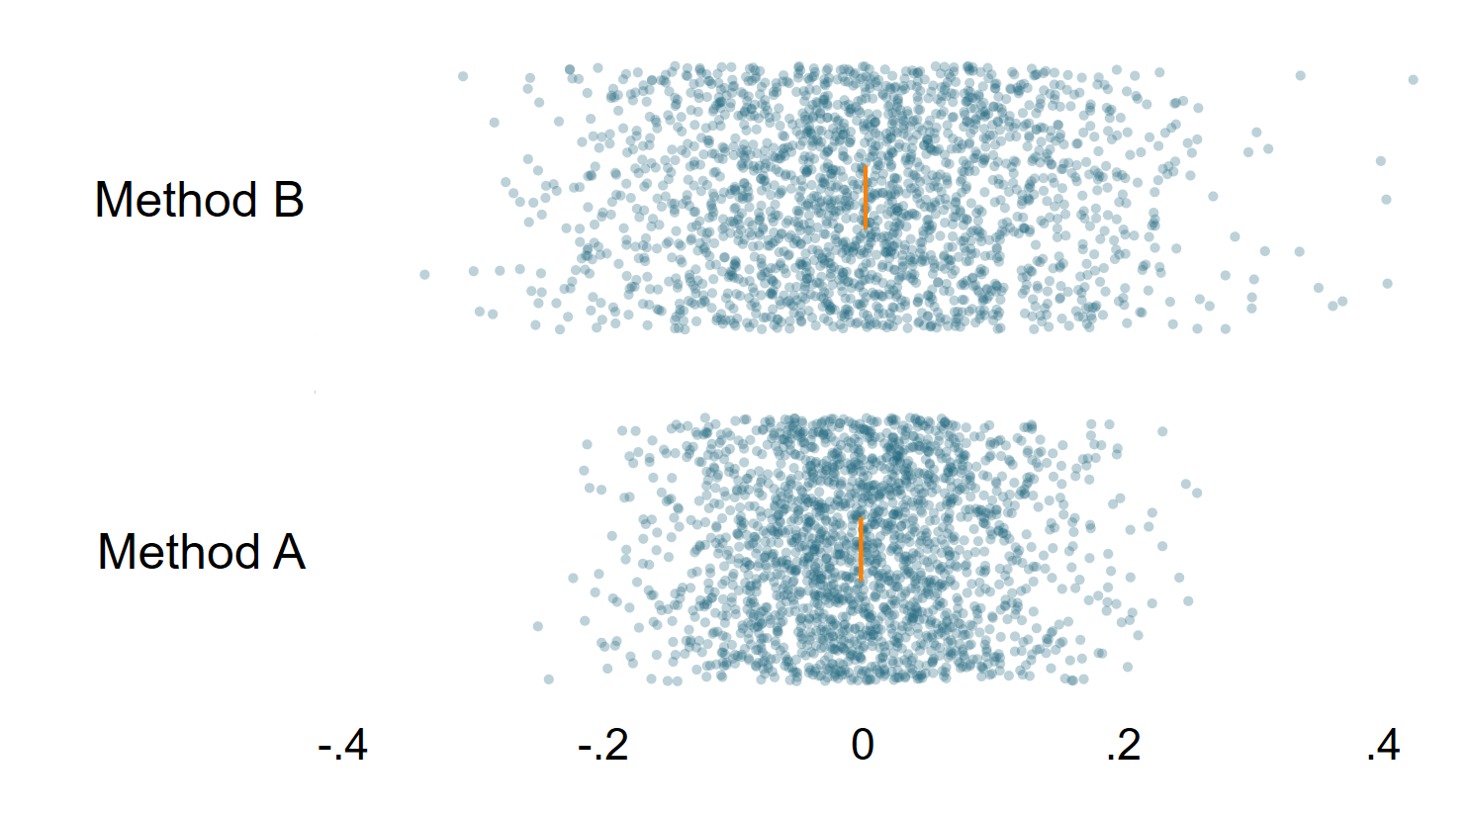
Exploring the estimates data: siman swarm
siman swarm [if] [in] [, options]

Slide 15
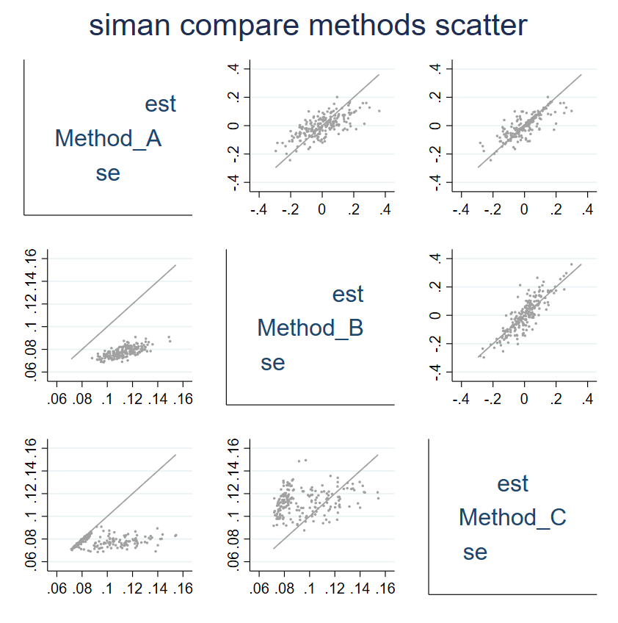
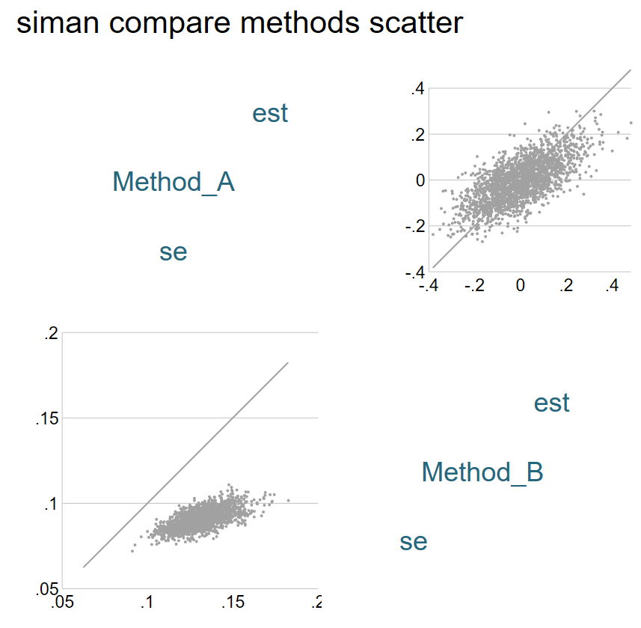
Exploring the estimates data: siman comparemethodsscatter
siman comparemethodsscatter [estimate|se] [if] [in]
[, options]

Slide 16
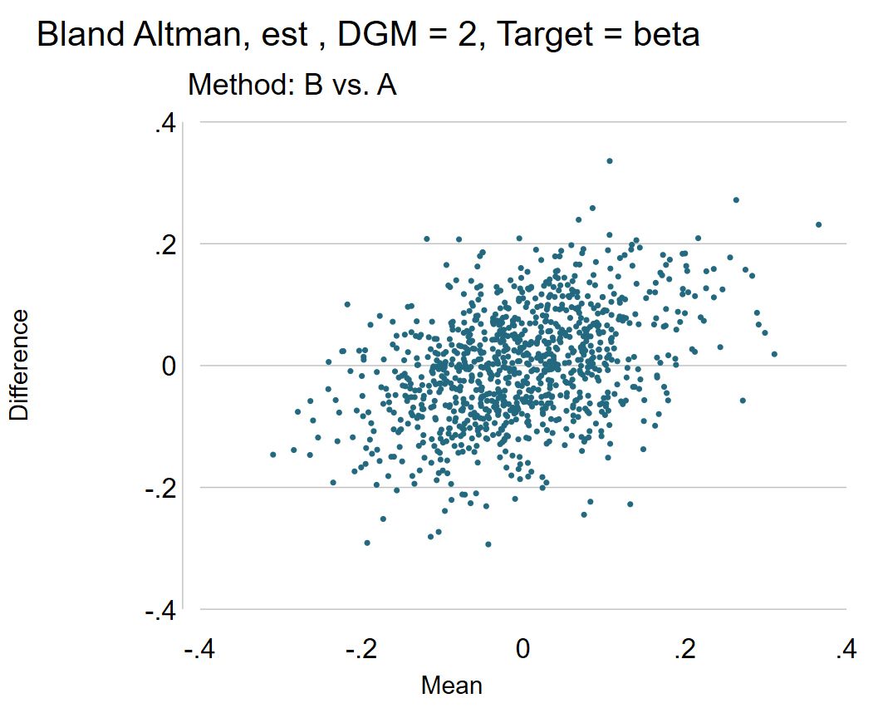
Exploring the estimates data: siman blandaltman
siman blandaltman [if] [in] [, options]

Slide 17
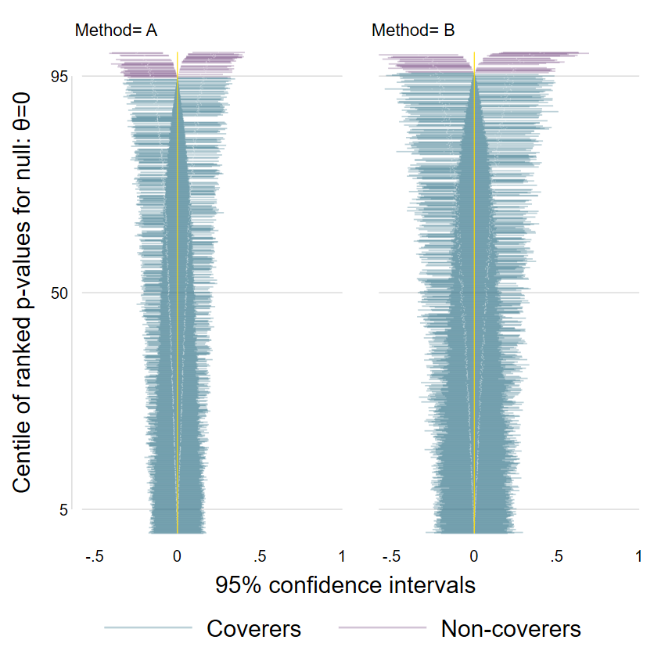
Exploring the estimates data: siman zipplot
siman zipplot [if] [in] [, options]

Slide 18
Creating performance measures
Once siman setup has been run, performance measures can be created using the command siman analyse
siman analyse [if], [performancemeasures perfonly replace]
performancemeasures as per simsum. If none of the following options are specified, then all available performance measures are computed…..
cover estimates the coverage of nominal confidence intervals at
the specified level.
mse estimates the mean squared error.
rmse estimates the root mean squared error.
relerror estimates the proportional error in the model-based
standard error, using the empirical standard error as gold
standard.
modelse estimates the model-based standard error.
relprec estimates the relative precision -- the inverse squared ratio
of the empirical standard error of this method to the
empirical standard error of the reference method. This
calculation is slow: omitting it can reduce run time by up to
90%.
ciwidth estimates the width of the confidence interval at
the specified level.
empse estimates the empirical standard error -- the standard
deviation of the point estimates.
mean the average (mean) of the point estimates.
sesims reports the number of simulations with non-missing standard errors.
bsims reports the number of simulations with non-missing point estimates.
bias estimates the bias in the point estimates.
power estimates the power to reject the null hypothesis that the
true parameter is zero, at the specified level.

Slide 19
Creating performance measures cont.
perfonly the program will automatically append the
performance measures data to the estimates data,
unless the user specifies perfonly for performance
measures only.
replace if siman analyse has already been run and the user
specifies it again then they must use the replace
option, to replace the existing performance measures
in the data set.

Slide 20
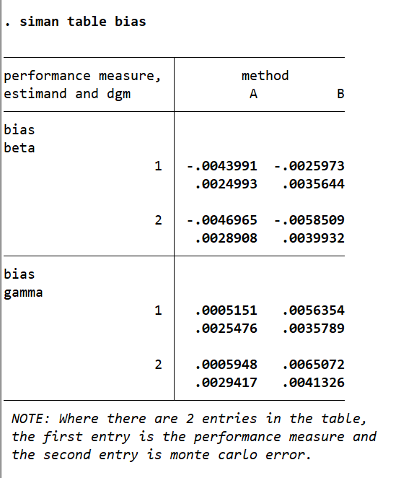






Creating performance measures: siman table
siman table [performancemeasures] [if], [column(varname)]
siman table bias

Slide 21
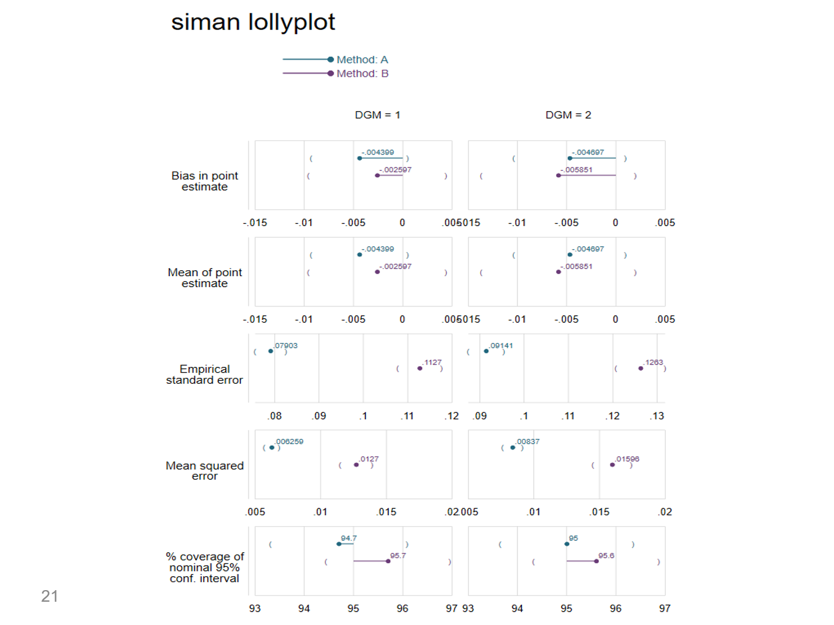

Creating performance measures graphs: siman lollyplot
siman lollyplot [performancemeasures] [if] [, options]

Slide 22
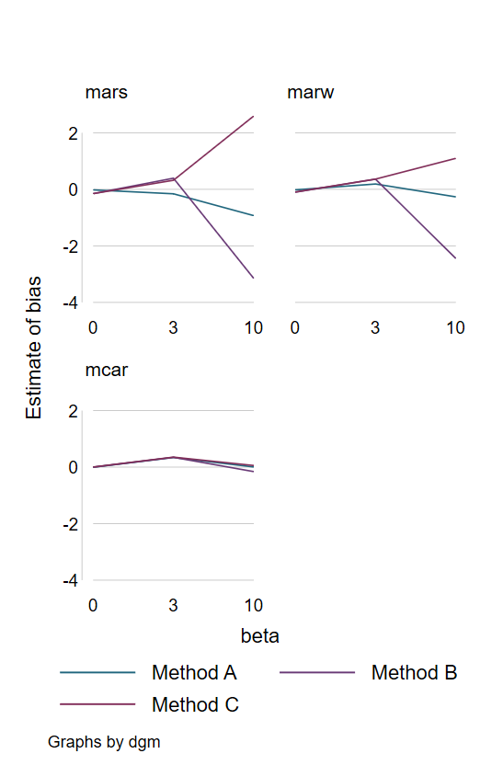
Creating performance measures graphs: siman trellis
siman trellis [performancemeasures] [if] [, options]

Slide 23
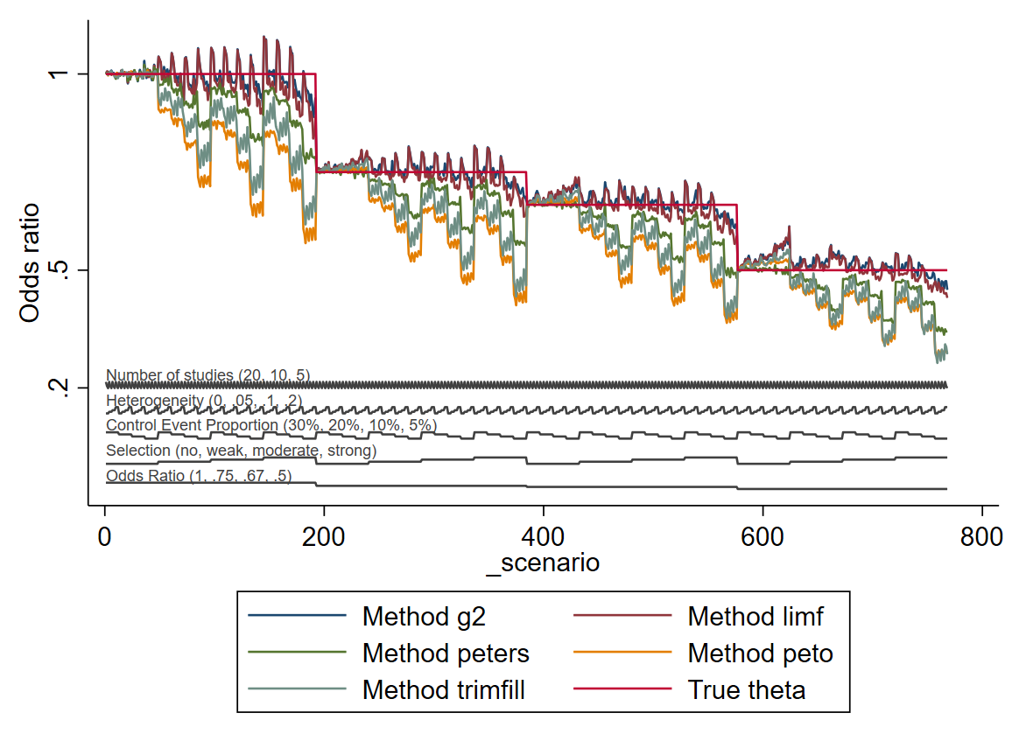
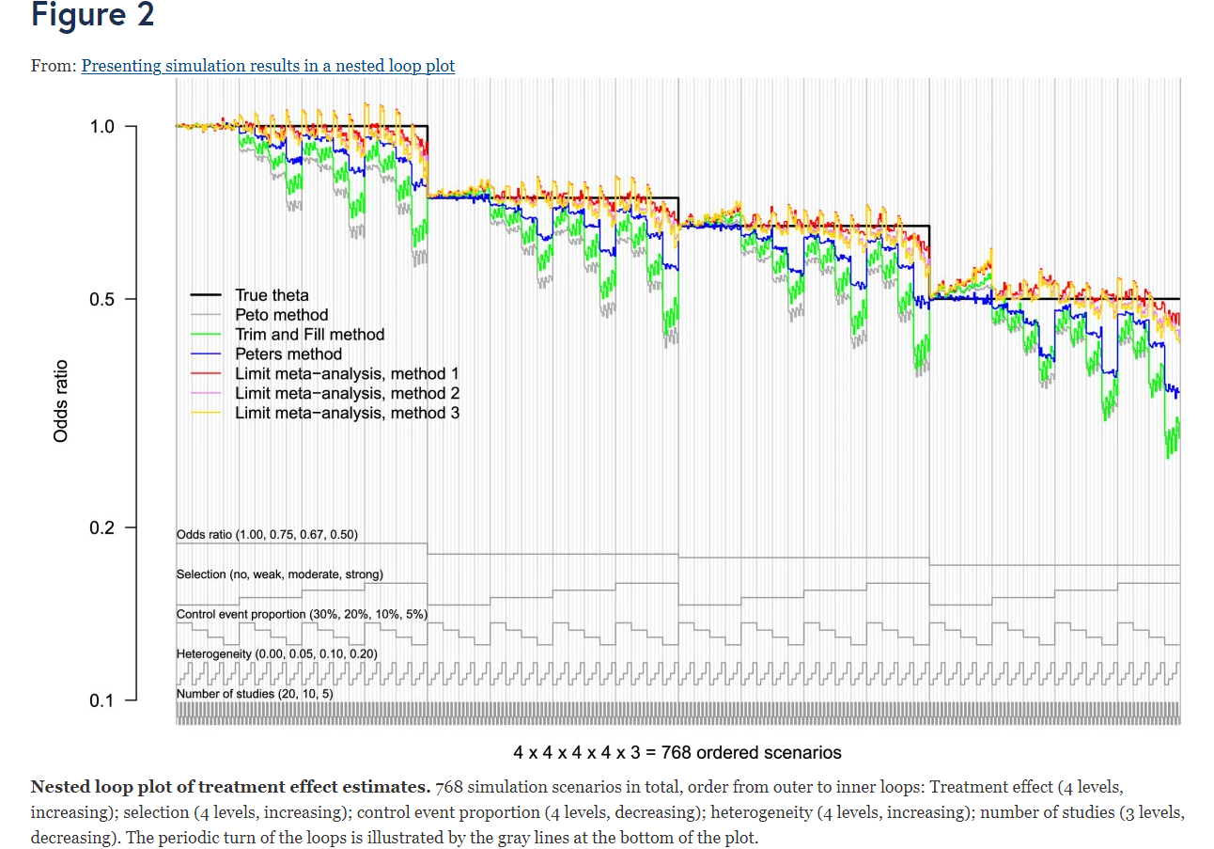
Creating performance measures graphs: siman nestloop
siman nestloop [performancemeasures] [if] [, options]

Slide 24
Software testing
We have a program of testing our unit’s software.
The siman suite is being tested on numerous data set formats by EMZ, IW, TM: long-long, long-wide, wide-wide, numeric and string, multiple methods, targets and dgms.
Error checking to make sure it fails when it is meant to (with a sensible error message).

Slide 25
Discussion
User-friendly software for analysing the results of simulation studies.
Multiple estimates and performance measures graphs available, visual tools to help assess the performance of different methods.
Paper is to be submitted to the SJ
siman to be released to SSC

Slide 26
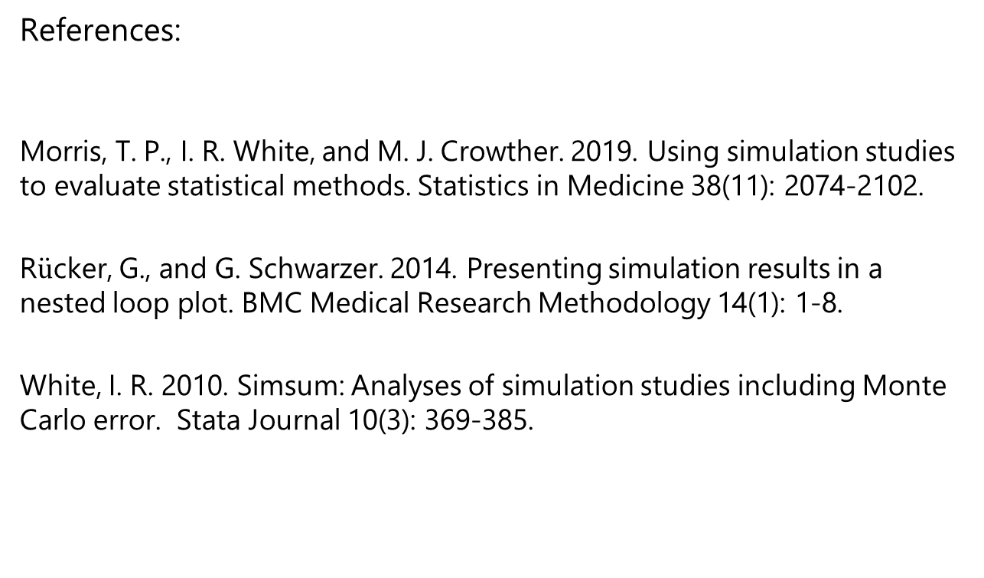
Thank you for listening
References:
Morris, T. P., I. R. White, and M. J. Crowther. 2019. Using simulation studies to evaluate statistical methods. Statistics in Medicine 38(11): 2074-2102.
R$\ddot{u}$cker, G., and G. Schwarzer. 2014. Presenting simulation results in a nested loop plot. BMC Medical Research Methodology 14(1): 1-8.
White, I. R. 2010. Simsum: Analyses of simulation studies including Monte Carlo error. Stata Journal 10(3): 369-385.

