Slide 1
Multiply imputing informatively censored time-to-event data
Ian R White, Patrick Royston
MRC Clinical Trials Unit at UCL, London, UK
7-8/09/2023 | UK Stata Conference

Slide 2
Plan
Motivation: missing data and censored data
Model & method for informatively censored data
Stata implementation by extending stsurvimpute
Example

Slide 3
Missing outcomes
Group 1
Group 2
13
27
22
21
16
42
33
38
28
?
33
?
29
11
Handle missing values by a missing at random assumption: missing outcomes are like observed outcomes (given similar covariates)
Notes:
Abstract for 15 minute talk:
Time-to-event data, such as overall survival in a cancer clinical trial, are commonly right-censored, and this censoring is commonly assumed to be non-informative. While non-informative censoring is plausible when censoring is due to end of study, it is less plausible when censoring is due to loss to follow-up. Sensitivity analyses for departures from the non-informative censoring assumption can be performed using multiple imputation under the Cox model [1]. These have been implemented in R [2] but are not commonly used. We propose a new implementation in Stata.
Our ‌existing ‑stsurvimpute‑ command (on SSC) imputes right-censored data under non-informative censoring, using a flexible parametric survival model fitted by -stpm2-. We extend this to allow a sensitivity parameter gamma, representing the log of the hazard ratio in censored individuals versus comparable uncensored individuals (the informative censoring hazard ratio, ICHR). The sensitivity parameter can vary between individuals, and imputed data can be re-censored at the end-of-study time. Because the -mi- suite does not allow imputed variables to be -stset-, we create an imputed data set in -ice- format and analyse it using -mim-.
In practice, sensitivity analysis computes the treatment effect for a range of scientifically plausible values of gamma. We illustrate the approach using a cancer clinical trial.

Slide 4
Censored outcomes
Group 1
Group 2
event
lost to follow-up
time →
end of follow-up
Handle censored values by a non-informative censoring assumption: censored outcomes are like observed outcomes (given similar covariates)
Notes:
Abstract for 15 minute talk:
Time-to-event data, such as overall survival in a cancer clinical trial, are commonly right-censored, and this censoring is commonly assumed to be non-informative. While non-informative censoring is plausible when censoring is due to end of study, it is less plausible when censoring is due to loss to follow-up. Sensitivity analyses for departures from the non-informative censoring assumption can be performed using multiple imputation under the Cox model [1]. These have been implemented in R [2] but are not commonly used. We propose a new implementation in Stata.
Our ‌existing ‑stsurvimpute‑ command (on SSC) imputes right-censored data under non-informative censoring, using a flexible parametric survival model fitted by -stpm2-. We extend this to allow a sensitivity parameter gamma, representing the log of the hazard ratio in censored individuals versus comparable uncensored individuals (the informative censoring hazard ratio, ICHR). The sensitivity parameter can vary between individuals, and imputed data can be re-censored at the end-of-study time. Because the -mi- suite does not allow imputed variables to be -stset-, we create an imputed data set in -ice- format and analyse it using -mim-.
In practice, sensitivity analysis computes the treatment effect for a range of scientifically plausible values of gamma. We illustrate the approach using a cancer clinical trial.

Slide 5
These assumptions are questionable
 | Missing outcomes | Censored outcomes
Assumption | Missing at random | Non-informative censoring
Testable? | No | No
Sensitivity analysis | Missing not at random | Informative censoring
How often done? | Sometimes | Approx never
Aim: easy-to-use methods for sensitivity analysis

Slide 6
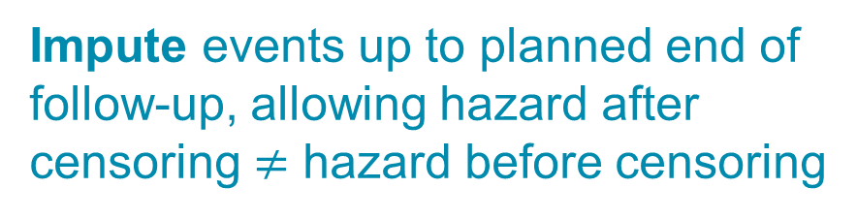
Aim 1
Impute events up to planned end of follow-up, allowing hazard after censoring $≠$ hazard before censoring
Group 1
event
lost to follow-up
time →
end of follow-up
Optionally impute events after end of follow-up

Slide 7
Aim 2
The abstract of the RT01 trial (Lancet 2014, described later) said
      “Biochemical progression or progressive disease occurred in 391 patients (221 [57%] in the control group and 170 [43%] in the escalated-dose group). At 10 years, biochemical progression-free survival was 43% (95% CI 38–48) in the control group and 55% (50–61) in the escalated-dose group (HR 0·69, 95% CI 0·56–0·84; p=0·0003).”
The analysis methods implicitly assumed non-informative censoring
  as do analyses of very many other data sets
How robust is this finding to possible informative censoring?

Slide 8
Model & method

Slide 9
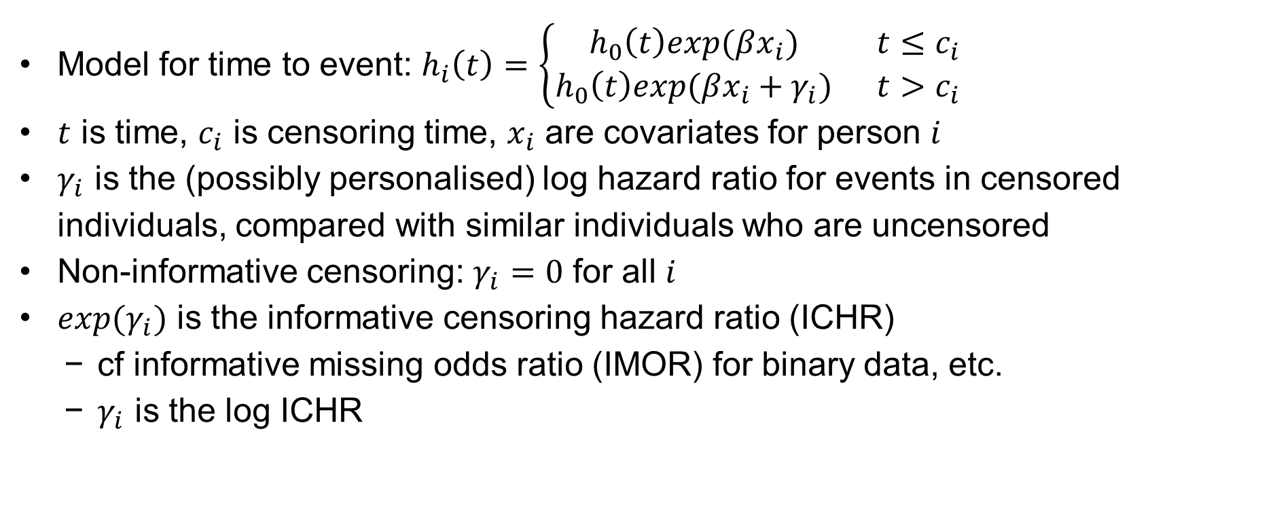
Simulating survival data after censoring
Model for time to event: $h_{i}\left(t\right)=\left\{\begin{matrix}h_{0}\left(t\right)exp(βx_{i}) & t≤c_{i} \\ h_{0}\left(t\right)exp(βx_{i}+γ_{i}) & t>c_{i}\end{matrix}\right.$
$t$ is time, $c_{i}$ is censoring time, $x_{i}$ are covariates for person $i$
$γ_{i}$ is the (possibly personalised) log hazard ratio for events in censored individuals, compared with similar individuals who are uncensored
Non-informative censoring: $γ_{i}=0$ for all $i$
$exp(γ_{i})$ is the informative censoring hazard ratio (ICHR)
  cf informative missing odds ratio (IMOR) for binary data, etc.
  $γ_{i}$ is the log ICHR
Notes:
Tim asked:
Doesn't this imply we also don't really believe the non-informative censoring model?
Do we know how we would modify this model if censoring were caused by an unobserved prognostic factor?

Slide 10
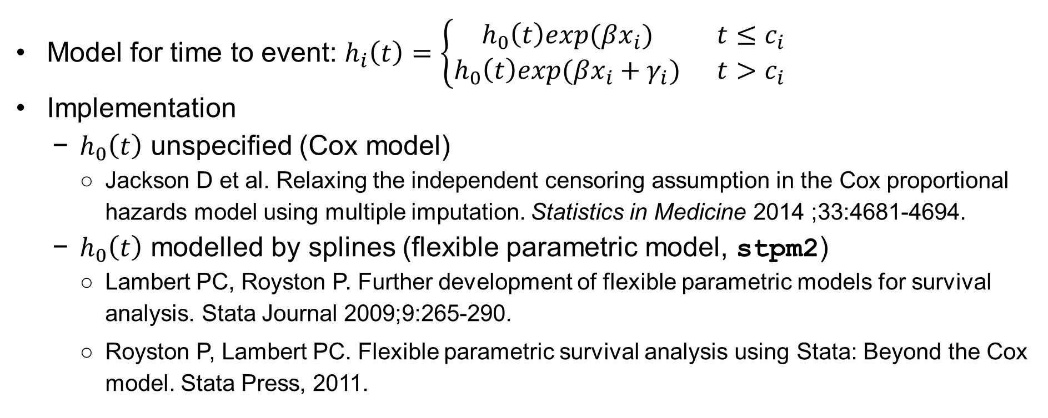
Simulating survival data after censoring
Model for time to event: $h_{i}\left(t\right)=\left\{\begin{matrix}h_{0}\left(t\right)exp(βx_{i}) & t≤c_{i} \\ h_{0}\left(t\right)exp(βx_{i}+γ_{i}) & t>c_{i}\end{matrix}\right.$
Implementation
  $h_{0}\left(t\right)$ unspecified (Cox model)
    Jackson D et al. Relaxing the independent censoring assumption in the Cox proportional hazards model using multiple imputation. Statistics in Medicine 2014 ;33:4681-4694.
  $h_{0}\left(t\right)$ modelled by splines (flexible parametric model, stpm2)
    Lambert PC, Royston P. Further development of flexible parametric models for survival analysis. Stata Journal 2009;9:265-290.
    Royston P, Lambert PC. Flexible parametric survival analysis using Stata: Beyond the Cox model. Stata Press, 2011.
Notes:
Tim asked:
Doesn't this imply we also don't really believe the non-informative censoring model?
Do we know how we would modify this model if censoring were caused by an unobserved prognostic factor?
Jackson: https://doi.org/10.1002/sim.6274

Slide 11
Stata implementation

Slide 12
stsurvimpute
Original version (SSC, 2011)
Imputes data after censoring, using a flexible parametric model (stpm2)
Assumes non-informative censoring
Creates a new variable to hold a single imputation
New version (in preparation)
Simple modification for informative censoring
Modification to produce multiple imputations and store them in ice/mim format
Why not mi format? See next…

Slide 13
Arranging the imputed data (1)
Consider id 29, censored (lost to follow-up) at 217 days, max followup 4775 days:
+---------------------------------+
| id timein time event |
| 29 0 217 0 |
+---------------------------------+
Can impute like this (like ice/mim format):
+------------------------------------------------+
| id _mi_m _mi_id timein time event |
|------------------------------------------------|
| 29 0 29 0 217 0 |
| 29 1 29 0 965 1 |
| 29 2 29 0 2710 1 |
| 29 3 29 0 4775 0 |
+------------------------------------------------+
mi doesn’t see missing data in _mi_m==0, so doesn’t accept imputed values

Slide 14
Arranging the imputed data (2)
Or can impute in an “stsplit” way, expressing censoring as missing data:
+-------------------------------------------------+
| id _mi_m _mi_id timein time event |
|-------------------------------------------------|
| 29 0 29 0 217 0 |
| 29 0 30 217 . . |
|-------------------------------------------------|
| 29 1 29 0 217 0 |
| 29 1 30 217 965 1 |
|-------------------------------------------------|
| 29 2 29 0 217 0 |
| 29 2 30 217 2710 1 |
|-------------------------------------------------|
| 29 3 29 0 217 0 |
| 29 3 30 217 4775 0 |
+-------------------------------------------------+
mi stset: “Imputed and passive variables may not be used as the basis for mi stset.”
Hence we use ice/mim format instead
(one record per person per imputed data set)

Slide 15
Example

Slide 16
RT01 trial
Phase 3 clinical trial run by MRC CTU
Patients: men with localised prostate cancer
Intervention: escalated dose of radiotherapy (“Esc 74Gy”)
Control: standard dose of radiotherapy (“Std 64 Gy”)
Outcomes: overall survival; biochemical progression-free survival (PFS)
843 men randomised 7jan1998-20dec2001 and followed to 2aug2011
Dearnaley DP, Jovic G, Syndikus I, et al. Escalated-dose versus control-dose conformal radiotherapy for prostate cancer: Long-term results from the MRC RT01 randomised controlled trial. Lancet Oncol. 2014;15(4):464-473.

Slide 17
Kaplan-Meier for PFS
Censoring by loss to follow up
Censoring by end of follow up

Slide 18

PFS after imputing: $γ=0$

Slide 19

PFS after imputing: $γ=1$

Slide 20
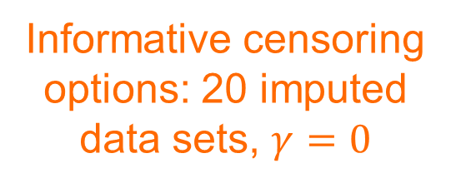
Code
baseline covariate
stset ti_bpfs_rc_event, failure(st_bpfs_rc_event) scale(365.25)
stsurvimpute trt rgrp, df(3) tvc(trt) dftvc(trt:3) scale(hazard) ///
m(20) gamma(0) seed(47618906) dots ///
recens(ti_eof)
mim: stcox trt rgrp
stpm2 options: fit flexible parametric model with different baseline hazard in each trial arm (trt)
Informative censoring options: 20 imputed data sets, $γ=0$
Recensor at 7jul2011

Slide 21

Systematic sensitivity analysis: vary $γ$
1
Results are robust to plausible
and implausible informative censoring mechanisms!
.9
.8
Treatment effect (HR)
.7
.6
.5
-1
-.5
0
.5
1
gamma in arm...
Esc
Both
Std
(Obs)

Slide 22
Future work
Proper imputation to allow for uncertainty in the stpm2 parameters
Imputation by trial arm
Handle multiple-record st data
How to check imputations

Slide 23
Acknowledgements
The RT01 trial team and participants
Vicki Yorke-Edwards for supplying the data

Slide 24
Discussion
gamma is the log informative censoring hazard ratio (ICHR)
  intuitive sensitivity parameter that can be elicited with clinical experts
  choosing a plausible range for gamma is key
  can allow gamma to vary e.g. by arm, by reason for censoring
Setting gamma=0 is not the same as analysing the observed data
Other summary measures are estimable e.g. RMST instead of HR
Is imputation beyond planned end of follow-up ever justified?
Can stsurvimpute be made compatible with mi?

Slide 25
Extras

Slide 26
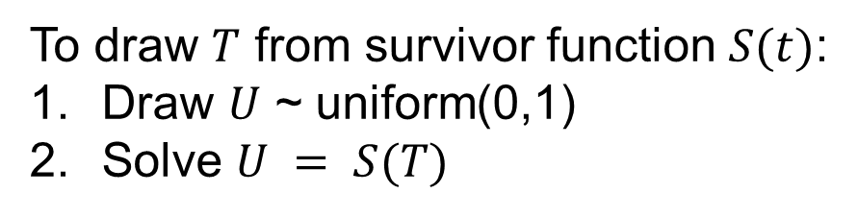
Simulating survival data
1
To draw $T$ from survivor function $S(t)$:
Draw $U$ ~ uniform(0,1)
Solve $U = S(T)$
.8
.6
P(T>t)
.4
.2
0
0
.5
1
1.5
2
2.5
time t

Slide 27

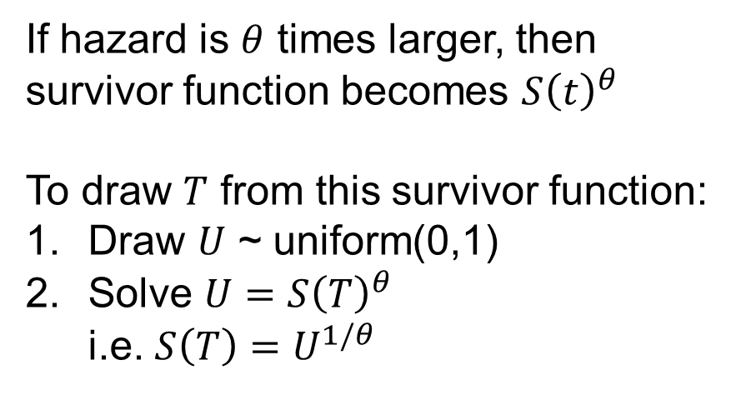

Simulating survival data
1
If hazard is $θ$ times larger, then survivor function becomes $S{\left(t\right)}^{θ}$
To draw $T$ from this survivor function:
Draw $U$ ~ uniform(0,1)
Solve $U=S{\left(T\right)}^{θ}$
i.e. $S\left(T\right)=U^{1/θ}$
$$S(t)$$
.8
.6
$$S{\left(t\right)}^{θ}$$
$$θ=3$$
P(T>t)
.4
.2
0
0
.5
1
1.5
2
2.5
time t

Slide 28
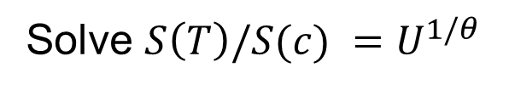

Simulating survival data after censoring
1
$$S(c)$$
Solve $S\left(T\right)/S(c) =U^{1/θ}$
P(T>t)
0
0
c
censor time
time t

Slide 29
The code: stsurvimpute
Old
gen double `F' = 100*(1 - `s' * `u’)
if `touse' == 1 & `dead' == 0
predict `generate', centile(`F’)
New
gen double `F' = 100*(1 - `s' * `u'^`inv_ICHR’)
if `touse' == 1 & `dead' == 0
predict `generate', centile(`F')

Slide 30
Kaplan-Meier for censoring
“Reverse KM”: censoring=1, event=0
Mostly loss to follow up
Mostly end of follow up

